Slide 1
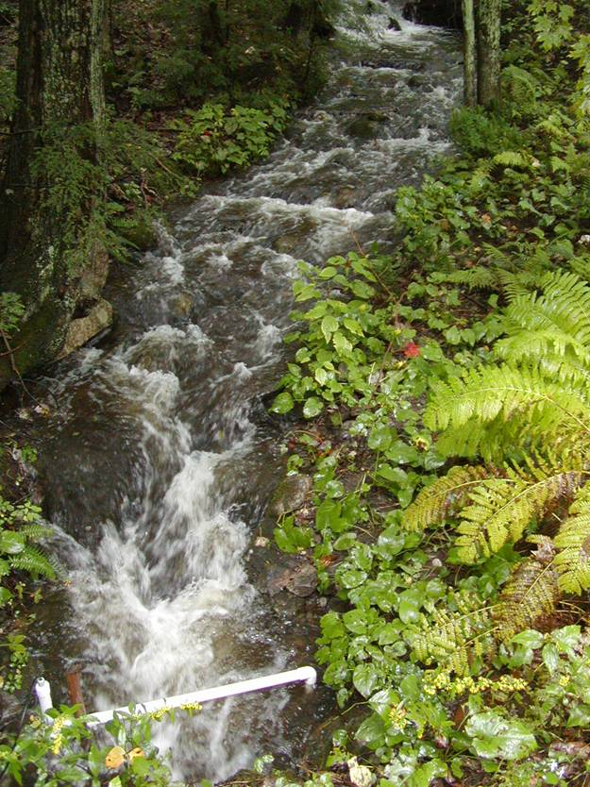
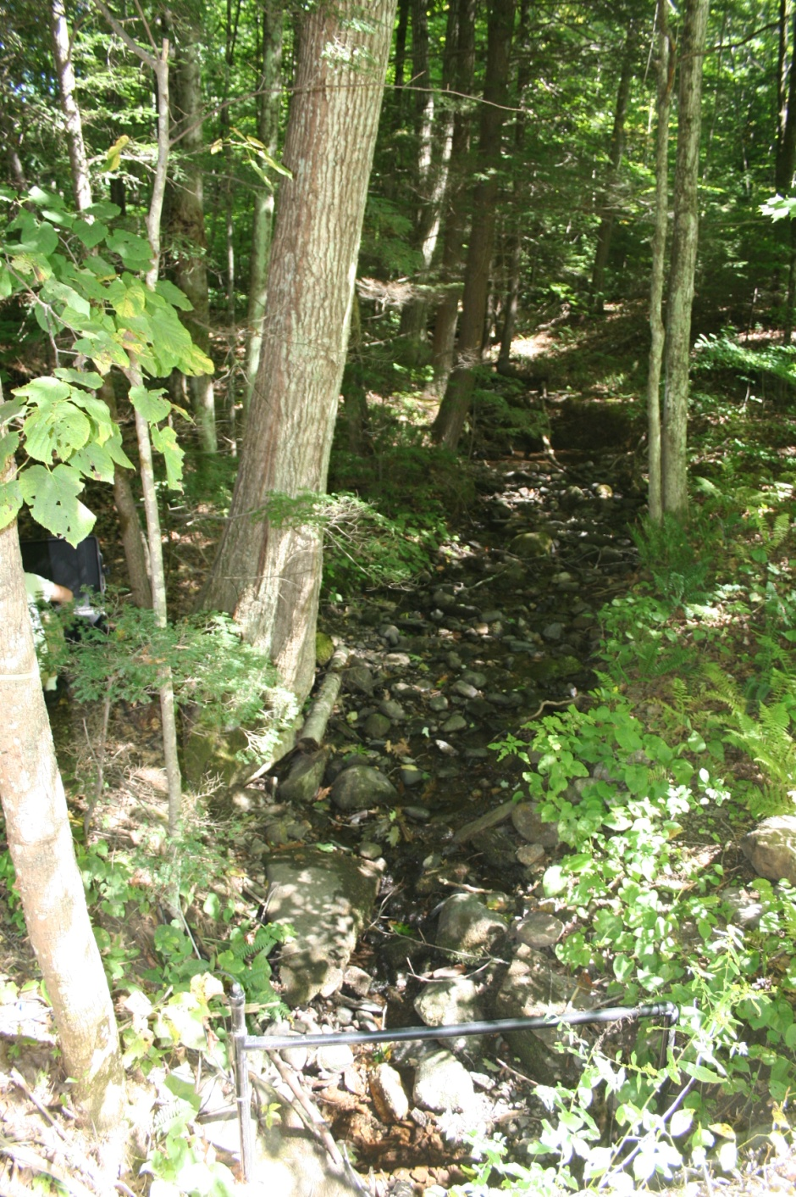
Brook trout population persistence
Ben Letcher
USGS, Conte Anadromous Fish Research Center, Turners Falls, MA
Keith Nislow
USFS, Northern Research Station, Amherst, MA
Mark Hudy
USFS, Fish and Aquatic Ecology Unit, Harrisonburg, VA
How does it work?

Slide 2
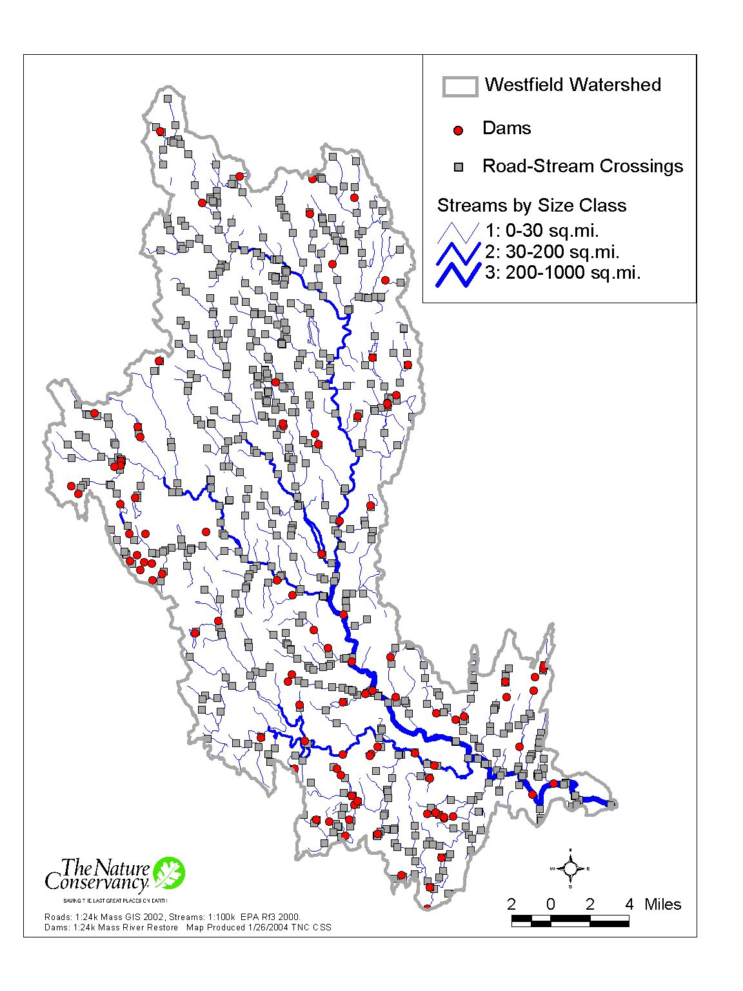
Threats to population persistence
Habitat fragmentation
  Isolated populations
Climate change
  Stream flow and temperature
Interaction of habitat fragmentation and climate change

Slide 3
Threats to population persistence
Most systems are highly fragmented
  Obvious effects for sea run
  Less obvious for stream networks
    How small is too small?
      Habitat and population size
    Why are there fish in very small, isolated streams?

Slide 4
Threats to population persistence
What are the consequences?
  Small population size (N and Ne)
  Loss of genetic variation
    Genetic drift
  Evolutionary response?
    Selection against movers or large fish
      Effects may be similar to fishery-induced evolutionary responses – loss of fishery value
      Reversible?
      Outbreeding depression following repair/reconnection?
      Loss of anadromous form?
  Life history shifts
  Loss of reproductive habitat

Slide 5
Threats to population persistence
Fragmentation bad enough, now climate change
  Direct effects
    How do stream flow and temperature affect vital rates?
Fragmentation and climate change interaction
  Increased importance of GCC with habitat fragmentation?

Slide 6
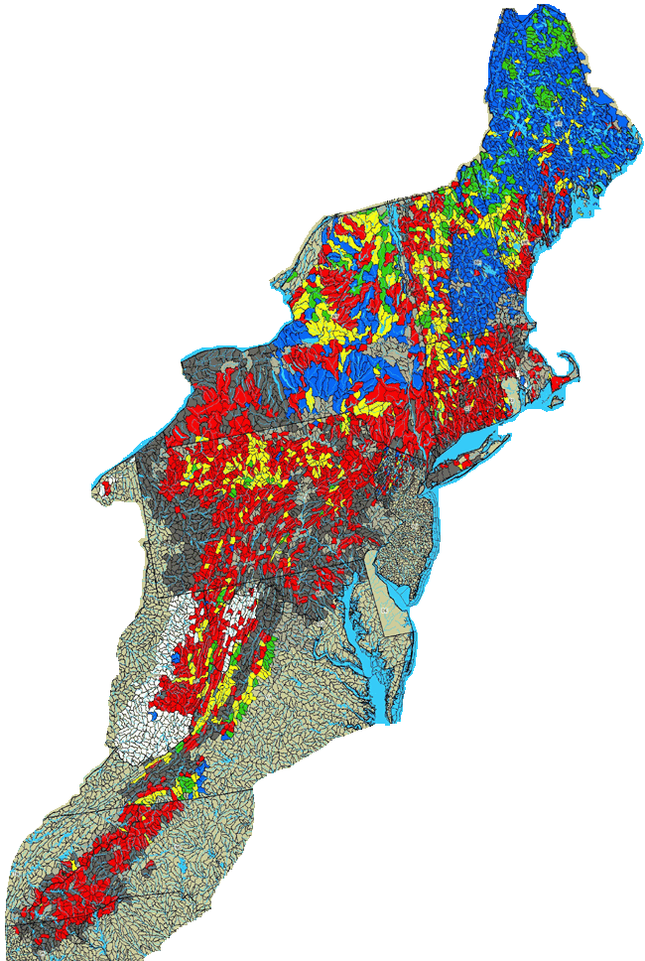
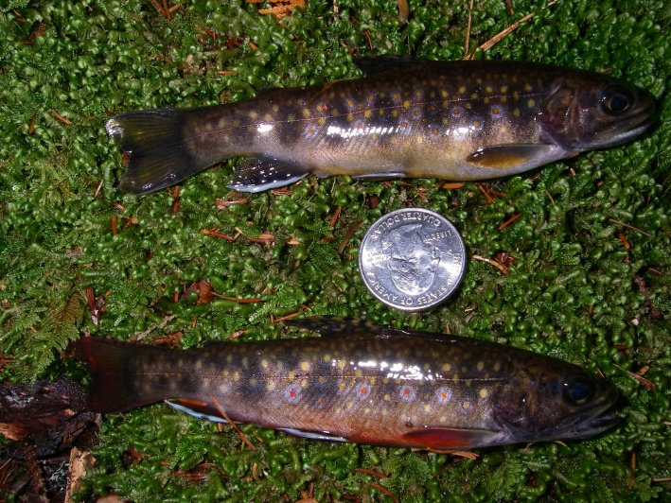
Overall goal
Develop models and tools to forecast population persistence
Identify reasons for persistence (mechanisms)
Endpoint – probability of persistence after x years
  Body size distributions
Specificity ↔ Generality
Eastern brook trout joint venture, 2007

Slide 7
Approach – working across scales
Hierarchical models
  Scale up
  Propagate error
Watershed
  Sub-watershed
    Catchment
Among-watershed
  Eventual goal

Slide 8
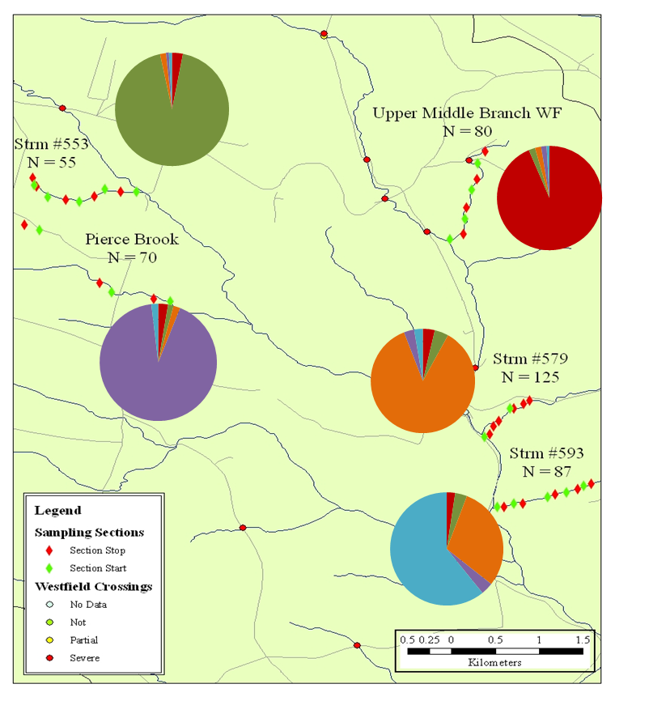
Spatial population genetics – what’s the right scale?
Fine scale (10 Km)
Westfield River, western MA
100-m long sample sites
12 microsatellites
Pairwise Fst 0.11 – 0.24
Assignment tests using Structure
Similar results in NH, VT, VA
Catchment and sub-watershed scales
Need detailed data, ~1km

Slide 9
Approach
Outcome
Population
processes
Age structure
Body size distributions
Environment
Stream Temperature
Stream flow
Habitat
Fish community
Reproduction
Body growth
Survival
Movement
Abundance
Ne, Nb
Density dependence
Catchment scale model

Slide 10
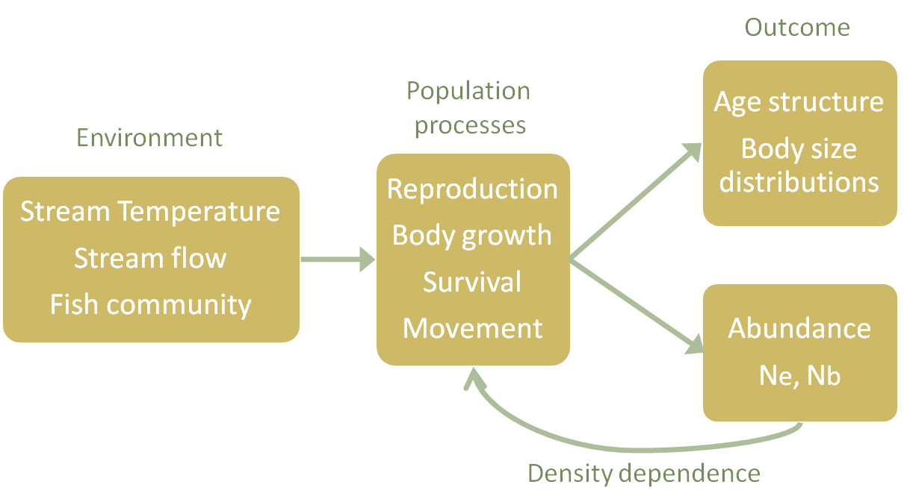
Approach
Connected catchment scale models
Outcomes
Sub-watershed abundance and body size
Movement
Movement
Movement patterns and catchment-specific production
Movement
Movement is observed with repeat sampling and PIT tag antennas
Sub-watershed scale model

Slide 11
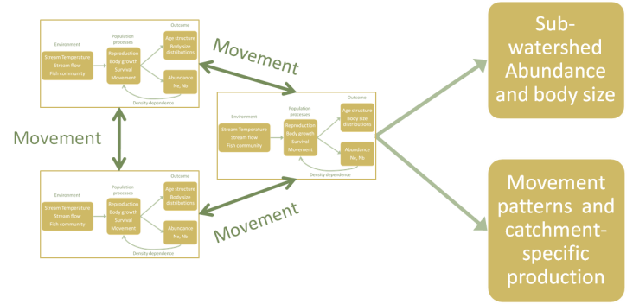
Approach
Connected sub-watershed scale models
Outcomes
Watershed-scale abundance and body size
Movement
Meta-population and genetic population structure
Watershed scale model
Movement is observed with radio tagged fish and is inferred with genetic data

Slide 12
Approach – broad questions
Do we need a detailed tagging study for each catchment?
  Define catchment types
    Size, connectivity
  Apply type to each unstudied catchment
  Use existing data to tune catchment type model to local conditions (Hierarchical Bayesian modeling)
Can we apply models across watersheds?
  Minimum local data needs?
Existing studies in MA, ME, NH
  Planned for VA, PA/NJ (DEWA)
Defining these relationships is key

Slide 13
Data and analysis
Sub-watershed model
  Variation among catchment types (size, connectivity)
  Movements among catchments
  Effects of isolation
Catchment model
  Effects of variation in stream flow and temperature on growth and survival
Climate change
  Population persistence for a catchment model and a sub-watershed model
Movement
Movement
Movement

Slide 14
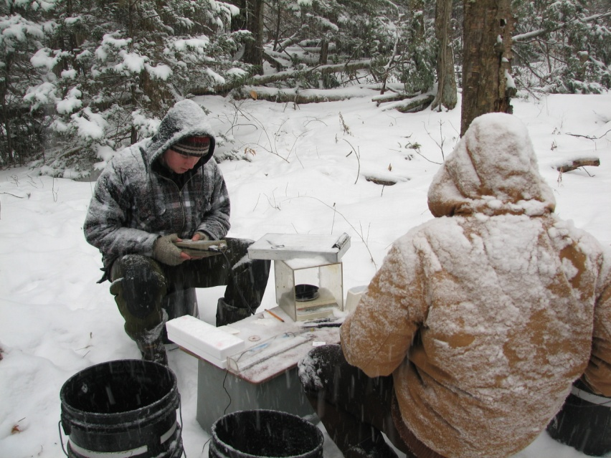
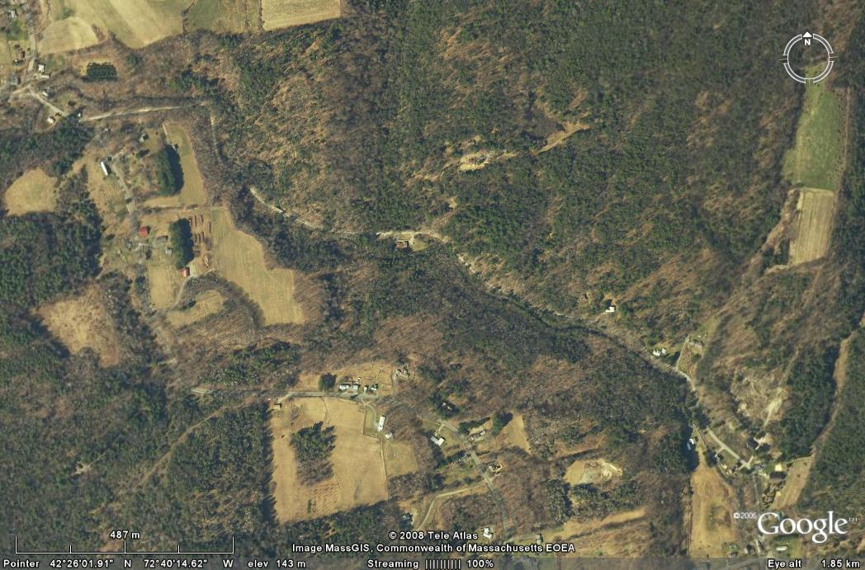
Study site
West Brook in Western MA (USA)
  Study initiated in 1997
  3 species
    Atlantic salmon, Brook trout, brown trout
  Study Salmon were stocked as fry (25mm) 1997-2004
  No stocking of trout, minimal fishing pressure
Long-term mark-recapture study
  1 km long mainstem
    3 tributaries
  Electro-fished four times a year
  March, June, September and December
  Fish are measured and PIT tags are implanted in fish caught for first time
  > 25,000 individual tags
Notes:
Mention first feeding

Slide 15
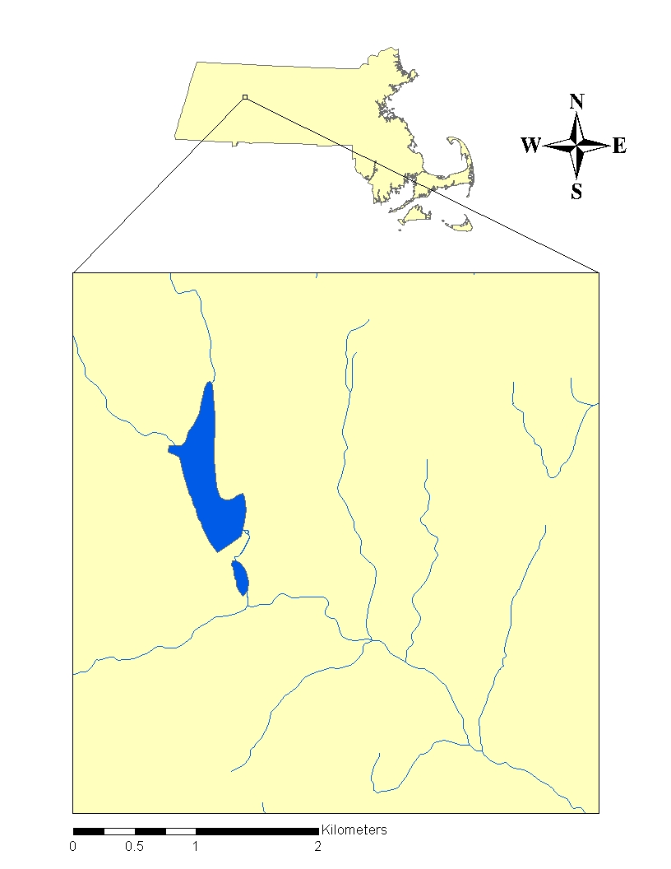
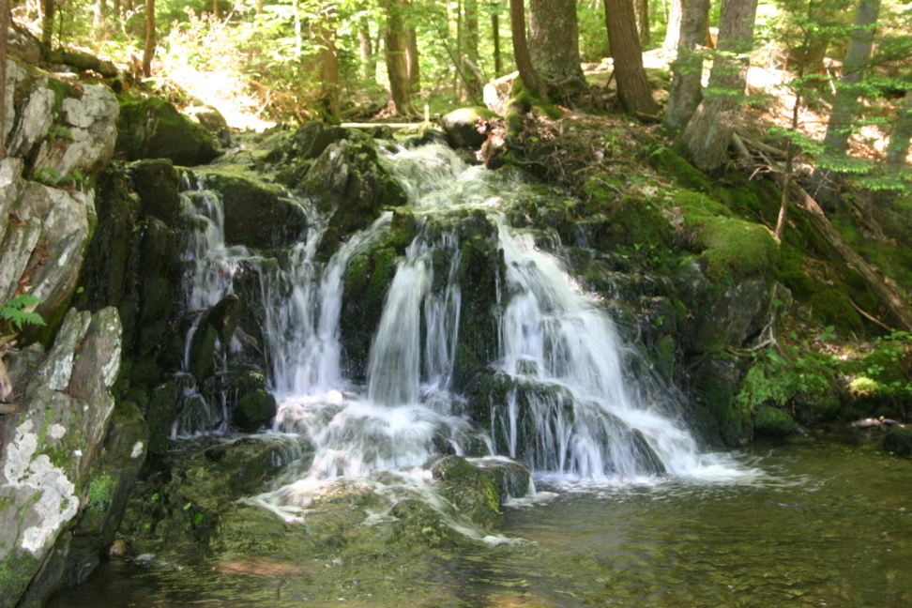
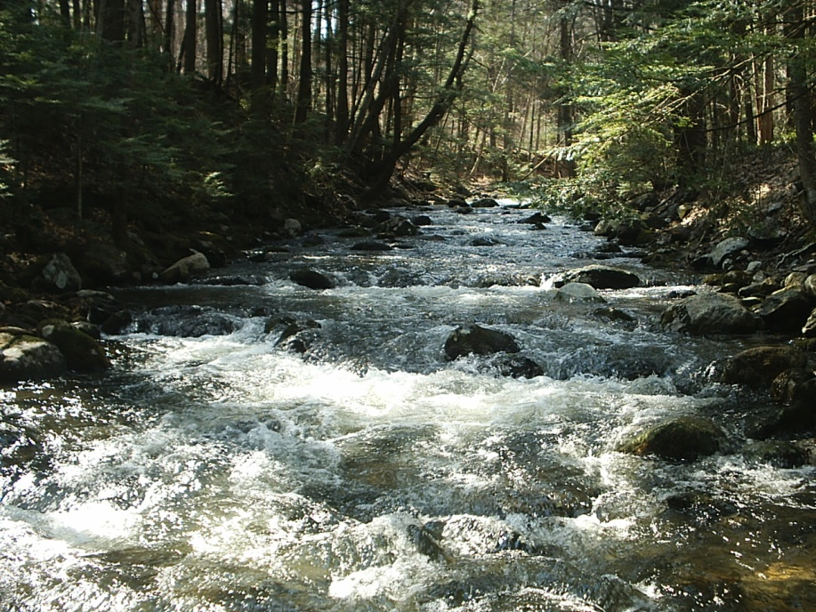
Field study site – West Brook
42° 25’ N; 72° 39’ W
Avg stream wet width = 4.5m

Slide 16
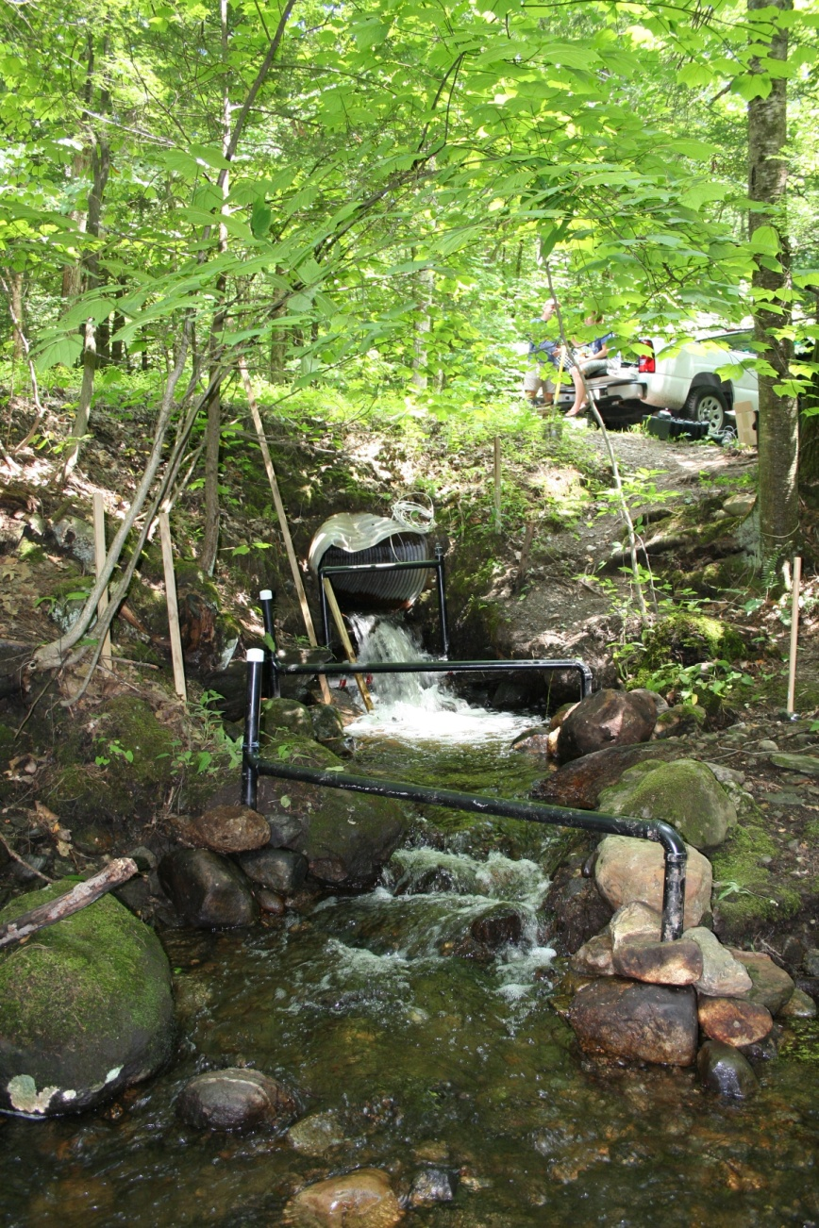
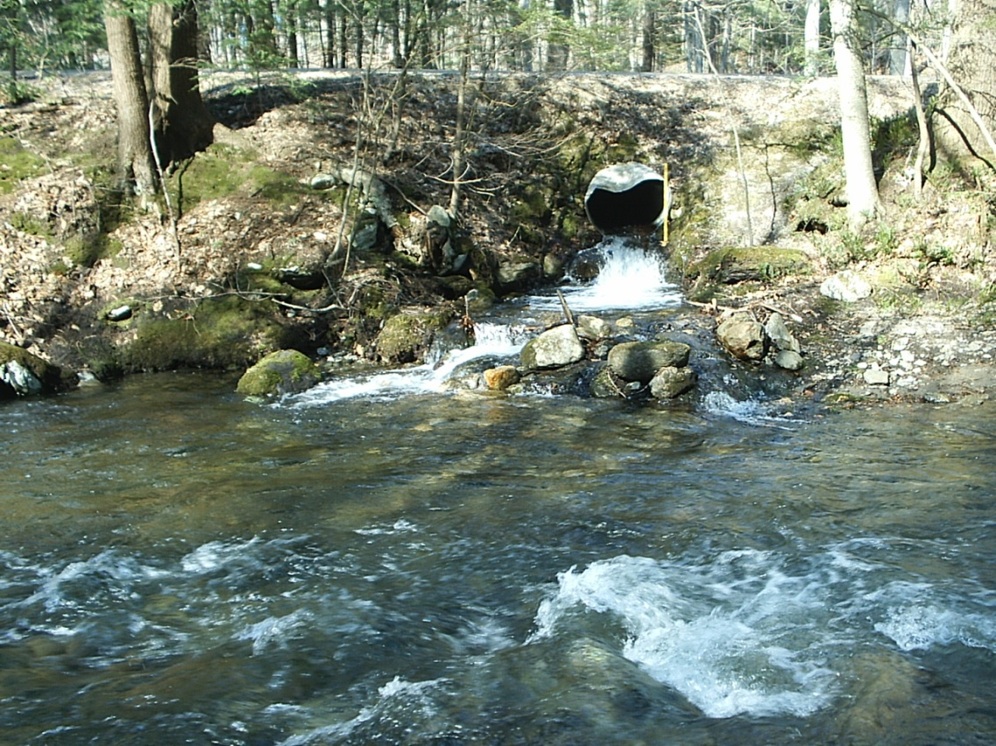
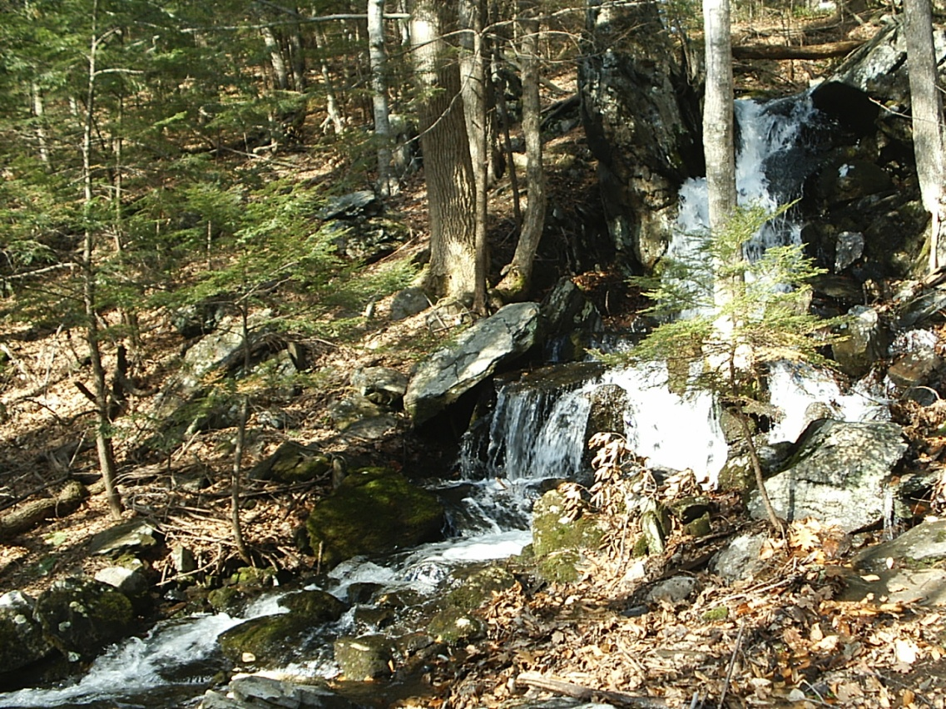
OpenSmall
Confluence
Avg stream wet width = 2m
Top of Reach

Slide 17
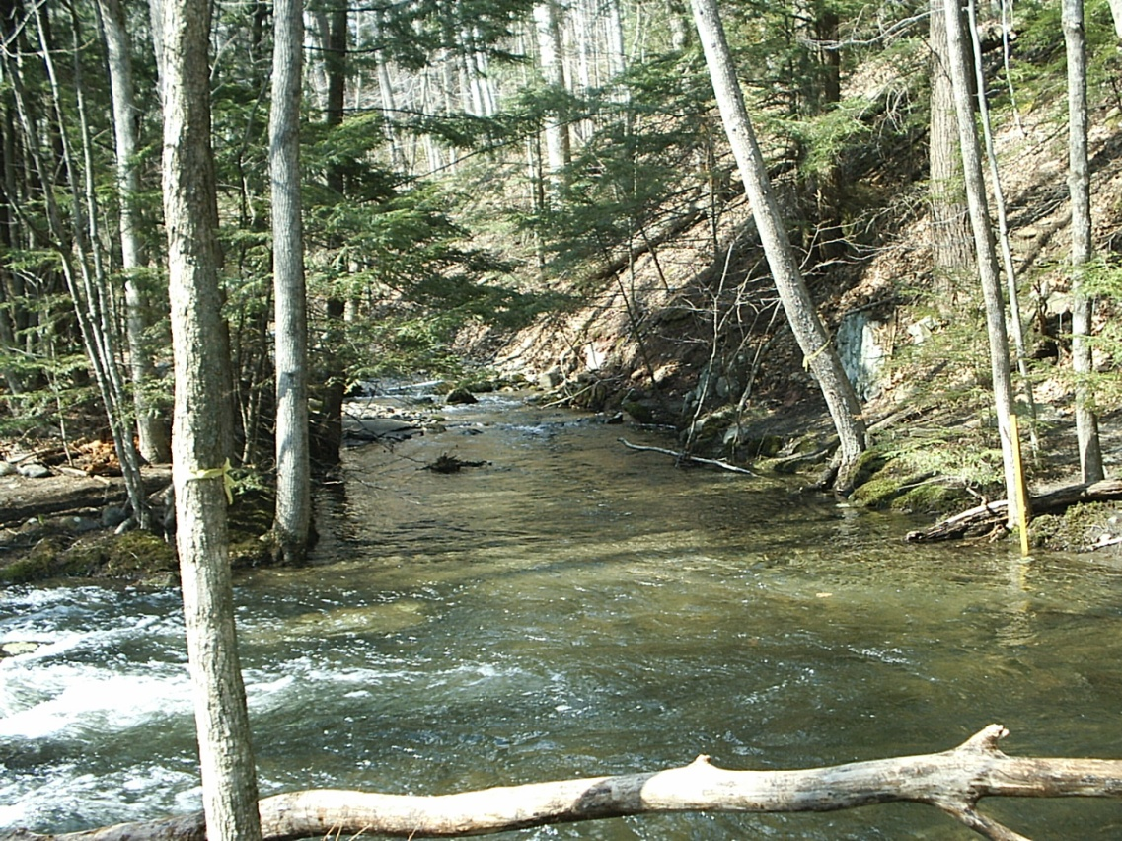
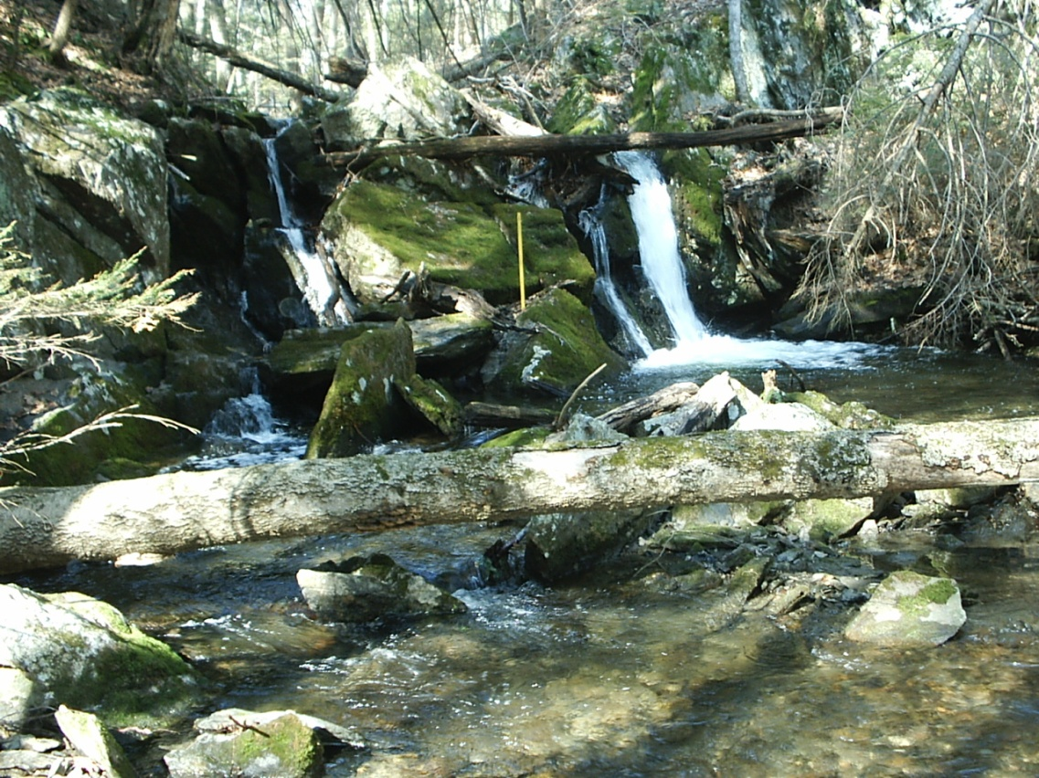
OpenLarge
Confluence
Avg stream wet width = 3m
Top of Reach

Slide 18
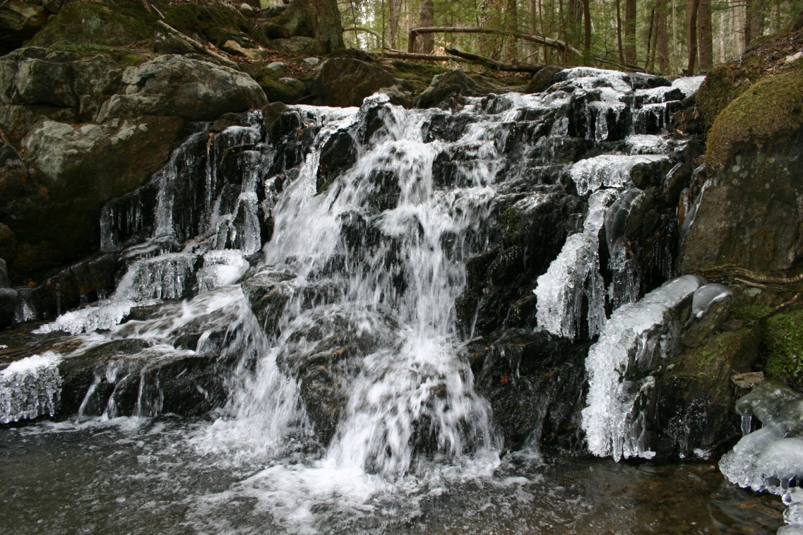
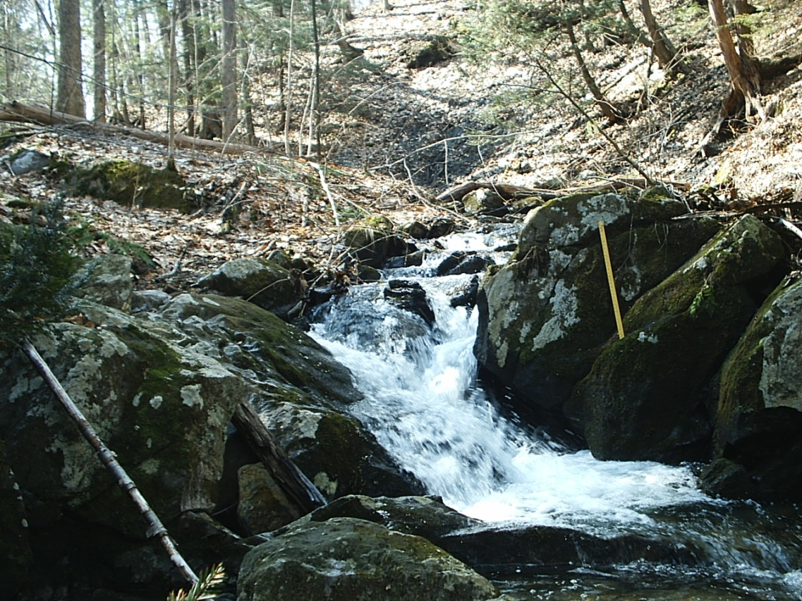
Isolated
Confluence
Avg stream wet width = 2m
Top of Reach

Slide 19
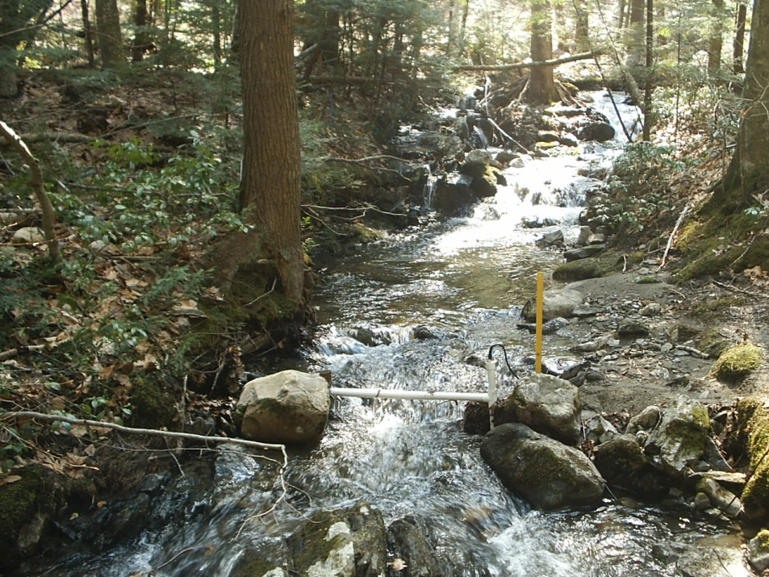
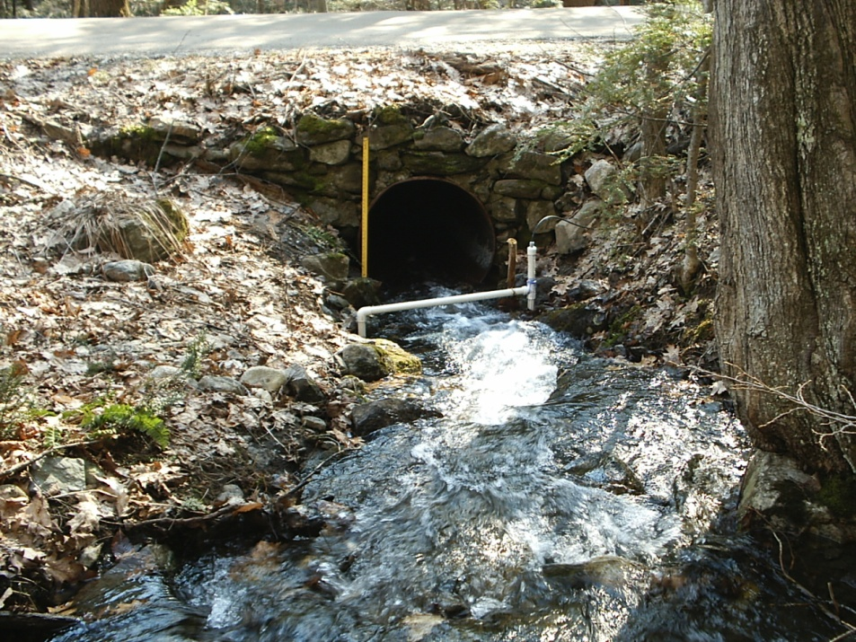

Stationary Antenna Locations
Antennas detect temporary and permanent emigrants: get closer to estimation of ‘true’ survival

Slide 20
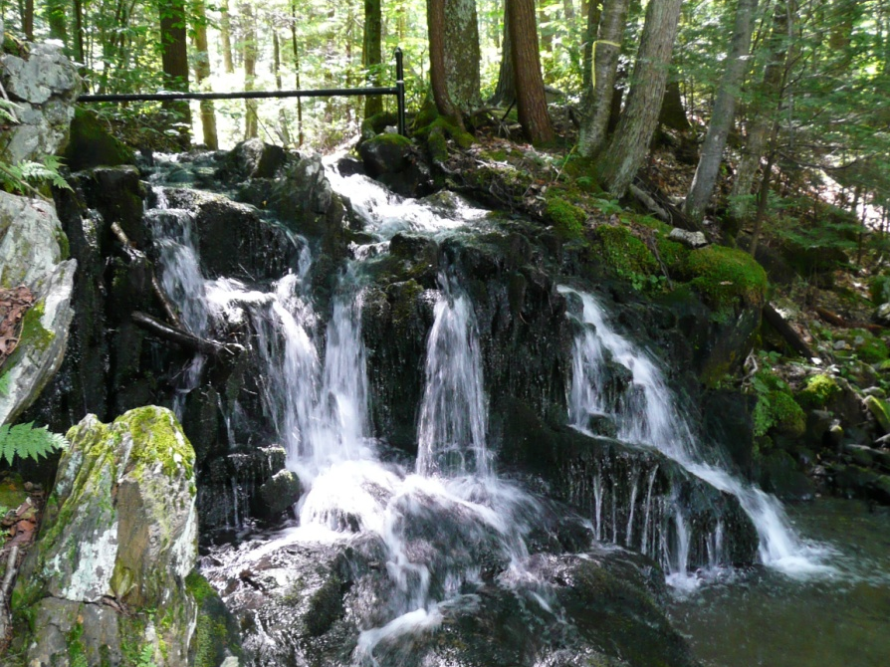
Summary – habitat fragmentation
In sub-watershed scale simulations, fragmentation of current open systems can lead to rapid tributary extinction (2-10 generations)
  Connectivity supports survival of large fish!
  Fragmentation means large fish cannot return to tribs
  Larger, ‘mainstem’ habitat and connectivity critical
BUT, currently isolated populations can persist
  Strong negative size-dependent survival
  Generation time in connected twice as long as in Isolated
  Size-dependent survival suggests selection against larger fish and selection against movement
  No emigration from isolated trib
Ability to survive isolation will depend on the race between adaptation to isolation and reduced survival resulting from fragmentation
Is there a common adaptation to isolation strategy
  Similar patterns in other systems
  Very similar patterns in white-spotted char

Slide 21
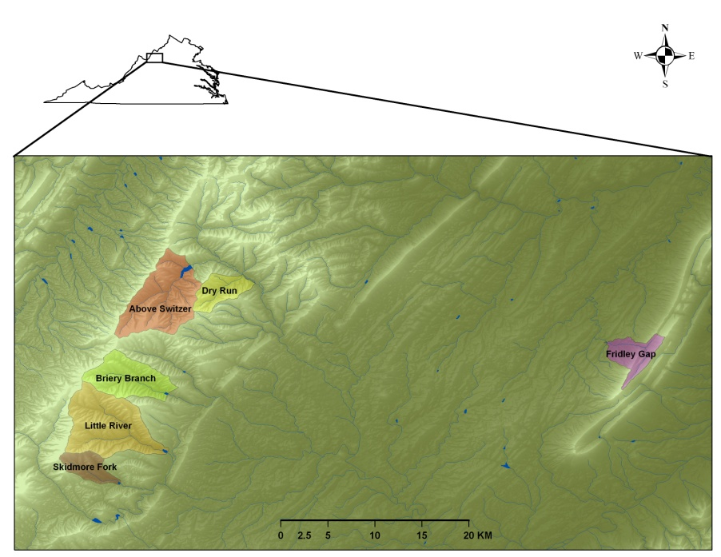
Consequences of fragmentation
VA populations
Average pairwise Fst = 0.12
Extremely small Nb (# of breeders)
Population | Genotypes | Nb | -95% CI | +95% CI | Area (Ha) | Length (km)
AS | 377 | 66.7 | 57.4 | 77.3 | 3807 | 27.4
BB | 36 | 20.8 | 16.6 | 26.2 | 2438 | 6.1
DR | 24 | 9.3 | 4.2 | 15.1 | 1217 | 8.1
FG | 99 | 122.9 | 89.9 | 177.4 | 590 | 6.2

Slide 22
Multi-species fragmentation effects
Greenbrier, WV
Comparison of abundances with and without culverts
Solid lines = passable culverts

Slide 23
Data and analysis
Sub-watershed model
  Variation among catchment types (size, connectivity)
  Movements among catchment
  Effects of isolation
Catchment model
  Effects of variation in stream flow and temperature on growth and survival
Climate change
  Catchment model
    Population persistence with GCC
  Sub-watershed model
    Population persistence with interaction of GCC and isolation
Movement
Movement
Movement

Slide 24
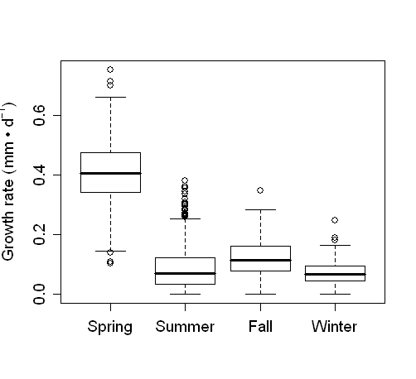
Seasonal growth rate variation
About ¾ of yearly growth occurs in spring

Slide 25
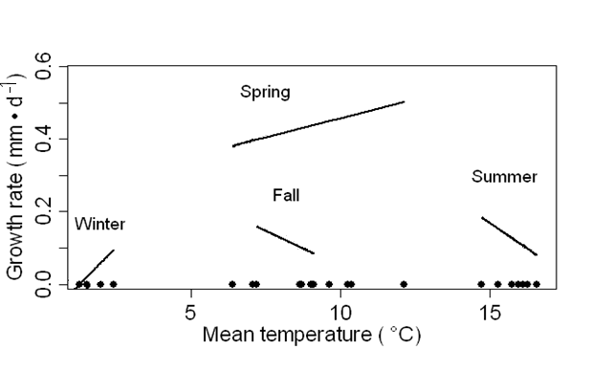
Interactive effect of season
Spring and summer
  Growth increases with temperature
Summer and Fall
  Growth decreases with temperature

Slide 26
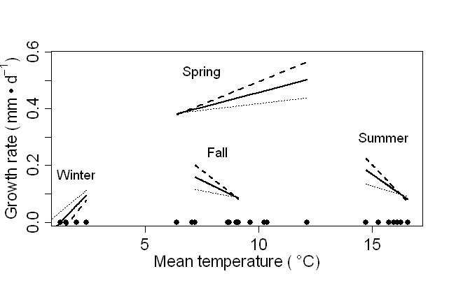
Interactive effects of flow
Spring
  Growth increased with temperature at a faster rate with higher flows
Summer and fall
  Higher flows exacerbated negative effects of temperature on growth
High Q
Low Q

Slide 27
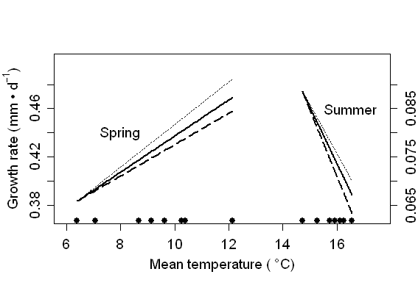
Interactive effects of density
Spring and summer
  Negative effects of density on growth
  Stronger at higher temperatures
Low D
High D

Slide 28
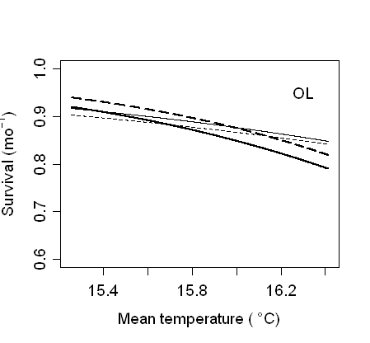
Survival summary
T and F had biggest effects in summer
Increase in T led to decreased survival across all size classes
Decrease in F led to lower survival for larger fish
  Low flow event ⬇ survival by 17%

Slide 29
Reproduction
Parentage assignment using microsatellites (12)
>3,000 fish genotyped
Mating strategies
  Size-dependent mating
    Yes, some evidence
  Age at mating
    Age 0 – age 4
    Mostly age 1 and age 2
  Family size
    Mostly 1
  Iteroparity
    Surprisingly little (5% repeat spawners)
Proportion
Number of families contributed to

Slide 30
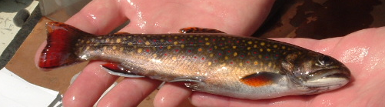
Simulation – climate change
Uses processes and parameter estimates from field
Simulate abundance over time
  100 years
  100 replicates
  Record years to extinction
Input variables - GCC
  Temperature
  Steam flow

Slide 31
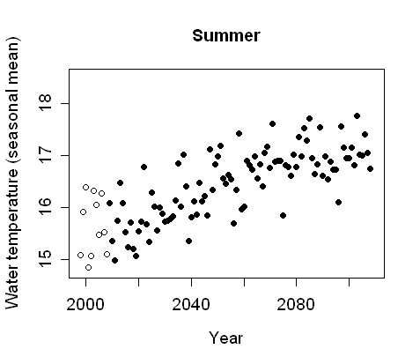
Forecasting climate change effects on population persistence
Rates of change – 100 years
Problem: can get incorrect process estimates for predictions outside the range of input variables
Solution: restrict range of observed input variables to approximate forecasts
Conservative, but reliable forecasts
Observed range
Observed range
➔
Gradual change (lose lower 0.25)
Range for prediction
 |  |  |  | →
➔
Gradual change (lose lower 0.5)
➔ | ➔
Gradual change (lose lower 1)
Observed range
Range for prediction
IPCC forecast for our stream
1
0.5
0.25

Slide 32
Simulation scenarios
Water temperature |  | Stream flow
Control |  | Control
Immediate change 0.75 |  | Immediate change 0.5
Immediate change 0.5 |  | Gradual change 0.5
Gradual change 0.75
Gradual change 0.5 |  |  | 0.75 ~ 1 C 0.5 ~ 2 C
 |  |  |  | T
 |  |  |  | F
 |  |  |  | F Winter
 |  |  |  | T
 |  |  |  | F Other
 |  |  |  | F Winter
➔
 |  |  | T
 |  |  |  | F Other
➔
➔ |  |  |  | T
➔ |  |  | T

Slide 33
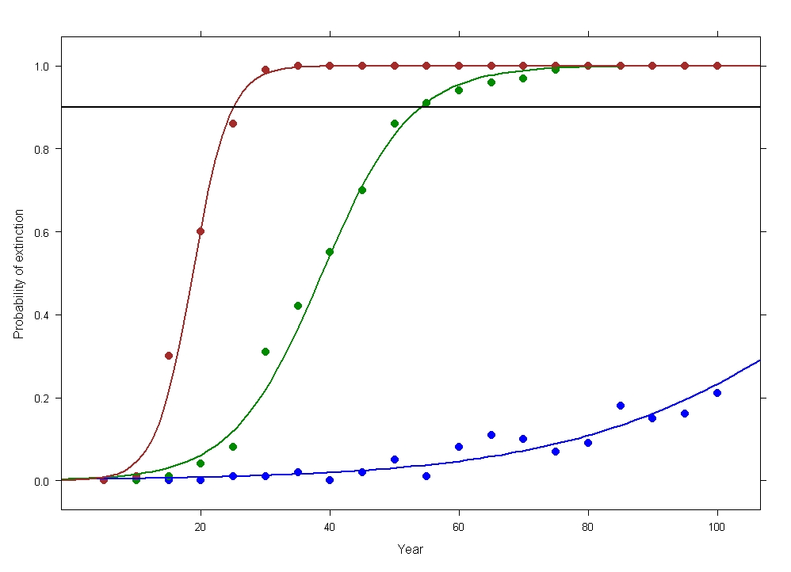
Simulation – T immediate
 |  |  |  | T
 |  |  |  | F
25.0 yrs
54.0 yrs
 |  |  |  | T
 |  |  |  | F
174 yrs
 |  |  |  | T
 |  |  |  | F

Slide 34
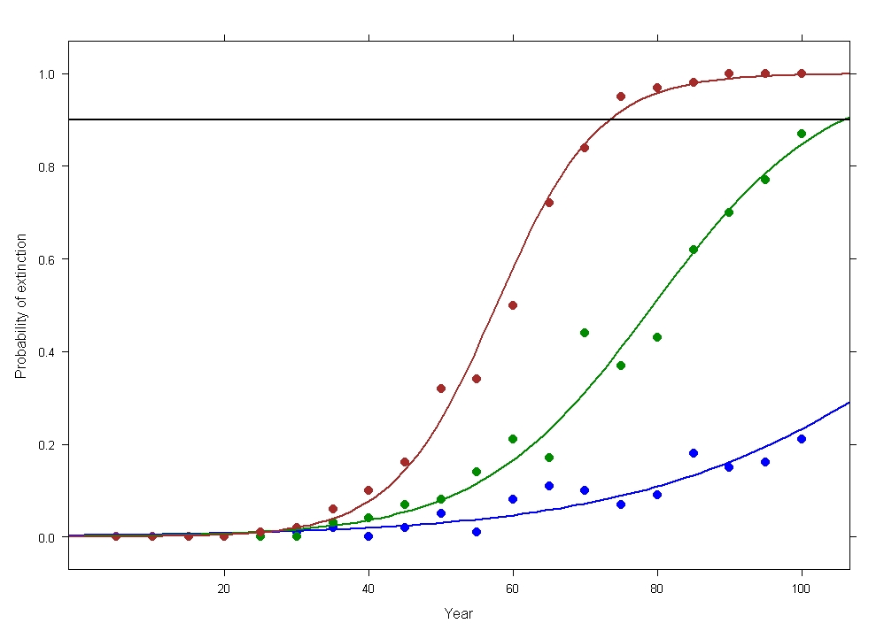
Simulation – climate change
➔ |  |  |  | T
 |  |  |  | F
73 yrs
105 yrs
➔ |  |  |  | T
 |  |  |  | F
174 yrs
 |  |  |  | T
 |  |  |  | F
Linear change in T
over 100 years

Slide 35
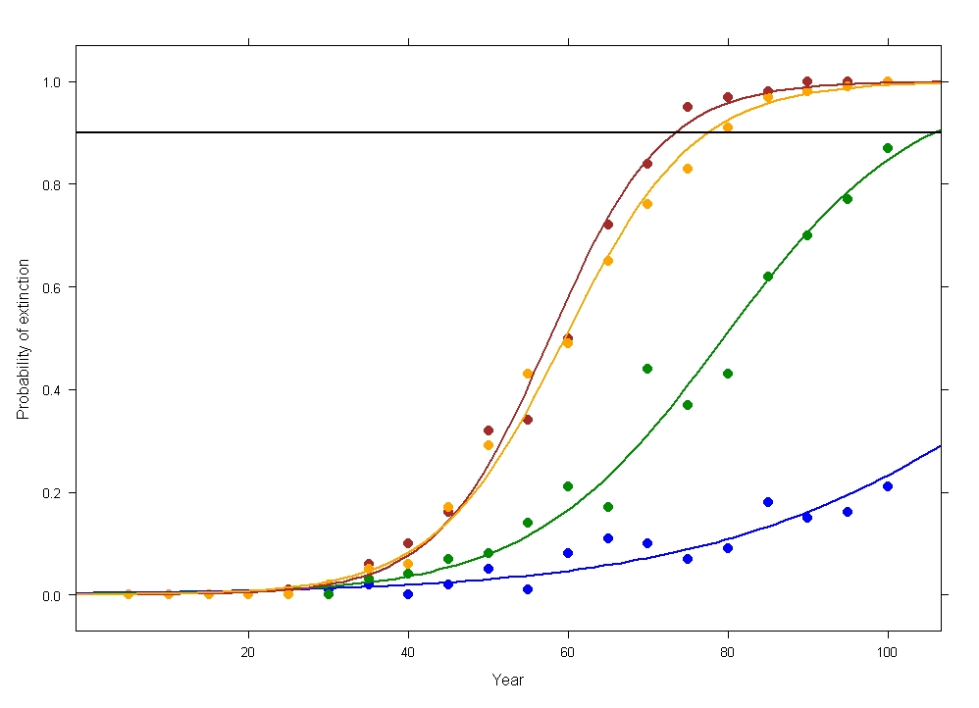
Simulation - gradual
➔ |  |  |  | T
 |  |  |  | F
73 yrs
➔ |  |  |  | T
 |  |  |  | F
77 yrs
➔ |  |  |  | T
 |  |  |  | F
➔
➔
105 yrs
 |  |  |  | T
 |  |  |  | F
Effects mainly operating through survival

Slide 36
Simulations – climate change
Control T x Control F = 174 yrs
1
0.5
0.25
T only
Conservative time to extinction < 1/3 of control

Slide 37
Simulation - climate change
Combined effects of connectivity and habitat quality (temperature)
  To what extent does groundwater buffer climate change effects?
  How does connectivity influence the buffering capacity of groundwater?
WB
OL
OS

Slide 38
Simulation - climate change
Under current movement conditions,
  All surface, persist for ~ 40 yrs
  Mainstem or tributaries groundwater ~ 60 yrs
  All groundwater ~ 120 yrs
But, groundwater cannot compensate for climate change effects with one-way movement out of tributaries ( ~ 20 yrs)
Restoring connectivity will have biggest effect in tributaries with ‘all-groundwater’ condition ( 6-fold increase in persistence time)

Slide 39
Decision support
Good understanding of catchment and sub-watershed population persistence models in MA
USFWS LCC and TNC funding to
  Scale up to watershed models
  Identify minimum data needs to scale up to among-watershed models
  Develop tools for managers to use
    Not limited to well-studied systems
    Apply to specific sites to address management needs
    Can we apply models range-wide? Need test sites
    Better local data = more realistic simulations

Slide 40
Decision support
How would the DSS work?
  Identify management question
  Identify space and time scales
  Pick stream segments on web-based map
  Load local data
    Environmental conditions, size distributions, community, genetics, movement data, etc
  Simulation will automatically fine-tune model to local conditions
  Run simulations
  Evaluate alternatives

Slide 41
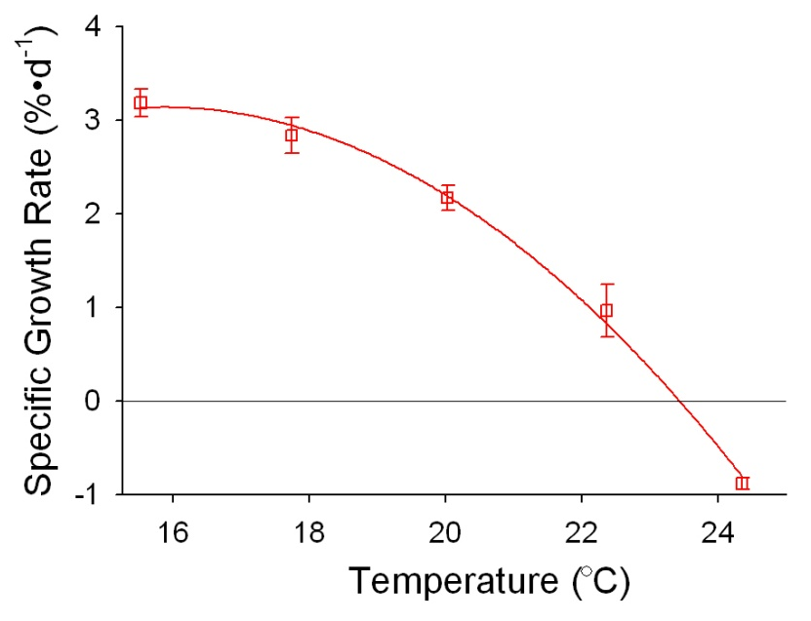
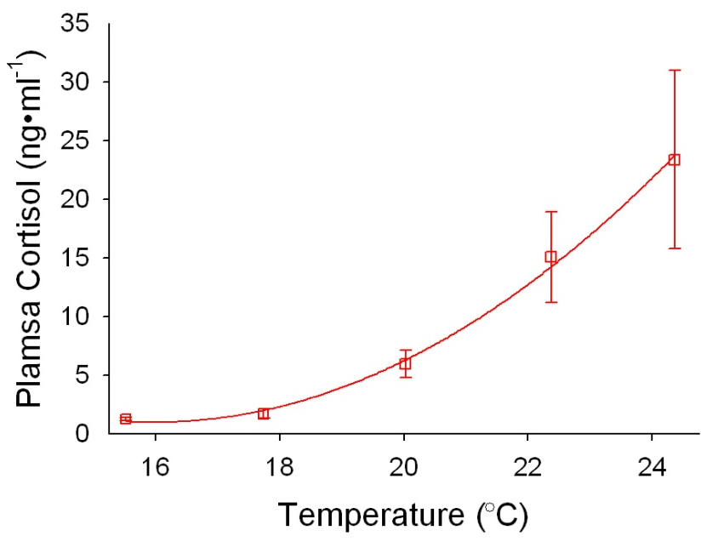
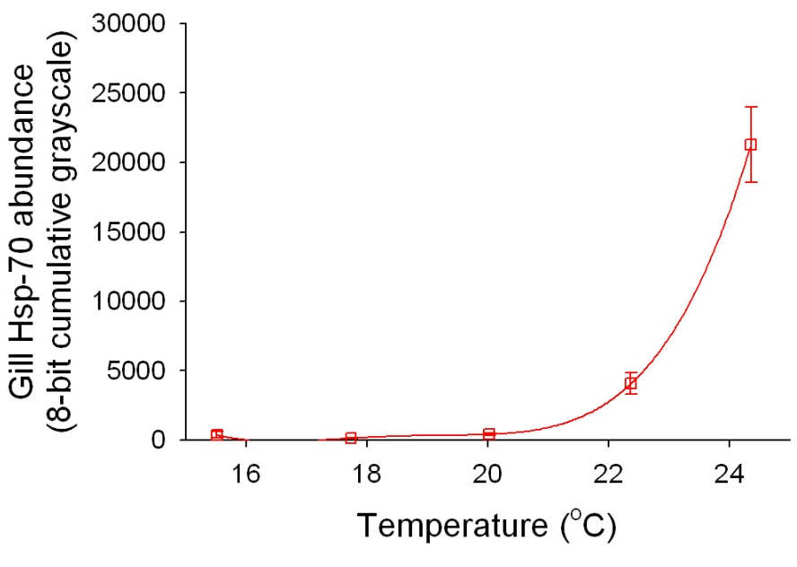
Temperature and Growth in Brook Trout
Growth
Cortisol and Heat Shock Proteins as Biomarkers of High Temperature Exposure
23.5 – Upper Limit for
Growth
Positive
Negative Growth
Stress Hormone (Cortisol)
Heat Shock Protein 70
Chadwick & McCormick unpublished

Slide 42
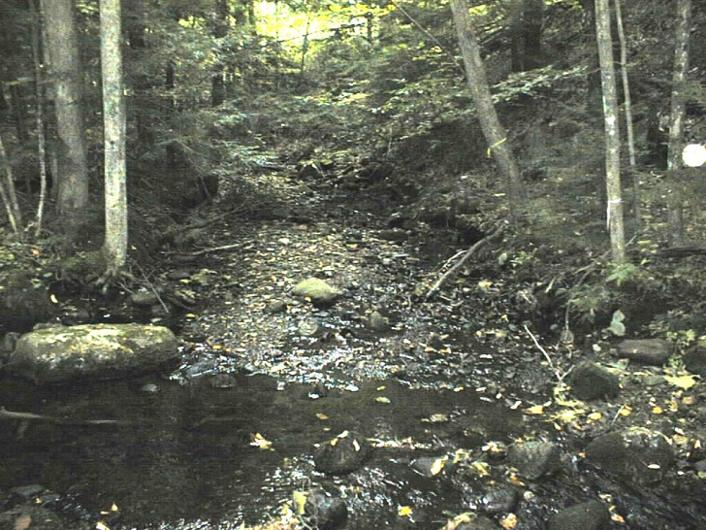
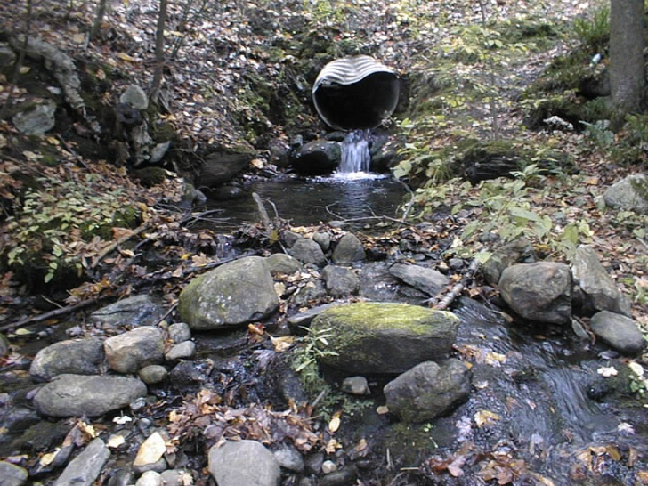
Acknowledgements
USFS
  Northern research station for partial funding
USGS/UMass
  Dr Scott Davidson, Dr Cailin Xu
  Krzysztof Sakrejda-Leavitt, Paul Schueller, Jason Coombs
  Jason Coombs, Todd Dubreuil, Matt O’Donnell, Aimee Varady, Gregg Horton, Doug Sigourney, Stephanie Carlson and the many other people who have helped sample the stream
  USGS LCC program
USFWS
  LCC program
  Connecticut River Coordinators Office
The Nature Conservancy
  Connecticut River Program

Slide 45
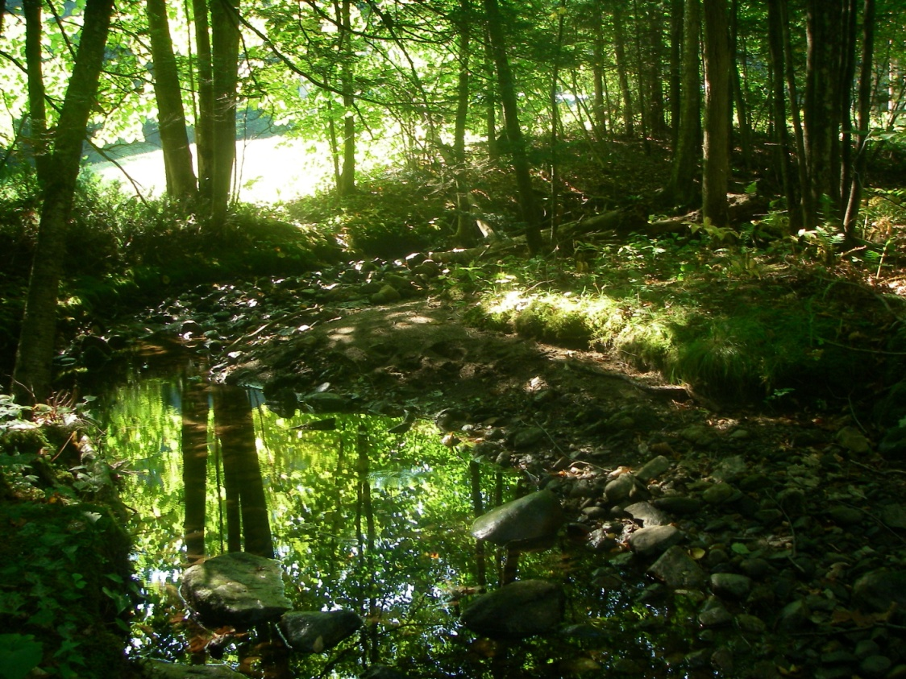
Big questions
Where are brook trout?
  Occupancy model
What is the minimum patch size for persistence?
  Strongholds or hopeless?
How do populations with very low effective population size persist?
  Adaptation to isolation?
How will brook trout populations respond to climate change?
  Range contraction
  Effects of stream flow and temperature
  Interactions between fragmentation and GCC
What are the best strategies to mitigate future challenges?

Slide 46
Big questions
Where are brook trout?
  Need comprehensive study
What is the minimum patch size for persistence?
  Working with Mark Hudy (USFS), Jason Coombs (USFS), Andrew Whiteley (UMass)
How do populations with very low effective population size persist?
How will brook trout populations respond to climate change?
  Range contraction
  Effects of stream flow and temperature
  Interactions between fragmentation and GCC
What are the best strategies to mitigate future challenges?

Slide 47
Overall goal
Challenges
  Scale
    How to scale up?
    Space
      Define a population – how big?
      Where are the fish?
      Importance of local adaptation?
      Can we apply models to unstudied or poorly studied systems?
    Time
      Can we apply short-term studies (1-15 years) to long-range forecasts (>50 years)?
      Timing of local adaptation?
    At what organizational level do we collect data?
      Population
      Individual
      Genotype
  Uncertainty
    How propagate across scales?
      For example, downscaled predictions of temperature and precipitation are uncertain in space and time
      Need an approach to propagate this (and other) uncertainty all the way to projections of population persistence
Eastern brook trout joint venture, 2007

Slide 48
Approach
Synthetic data collection and analysis to:
  Account for multiple sources of uncertainty
  Allow error propagation
  Provide answers in form of statistical distribution
    How certain are we of result?
Data
Analysis
Model
Simulation
Management
tool

Slide 49
Approach
Fine-scale data collection at multiple sites
  ~ 1 km
  Seasonal
  Tagged individuals
Model dynamics and uncertainty using Bayesian estimation
  Growth
  Survival
  Reproduction
  Movement
Combine statistical models into simulations
  Link growth and survival - interactions
Develop management tool - DSS
  Web-based
  Evaluate alternate management strategies
Data
Analysis
Model
Simulation
Management
tool

Slide 50
What questions can we address?
Habitat fragmentation
  Which barriers do we prioritize for removal/repair?
Water withdrawal
  How much water can be extracted?
Importance of water source
  How does extent of groundwater input affect persistence?
Climate change forecasts
  What are the effects of variation in stream flow, temperature?
Interactions
  How much will effects of isolation and water supply be magnified under GCC?

Slide 52
Overview
Data collection
Individual tags,
3 species,
Multiple rivers
Multiple cohorts
Statistical models
Body growth, Survival, Movement
Simulation models
Predict population size/persistence
Watershed-scale movement models
Genetics
Radio-tags
Decision support
Apply models to management ?s
Working groups
Web page
Goal
  Develop DSS for brook trout / salmonids
  Develop general approach
Approach
  Data-driven models of population persistence on the landscape
Products
  Detailed models of population persistence
  Web page
  Workshops

Slide 53
Progress/funding to date
Data collection
Individual tags,
3 species,
Multiple rivers
Multiple cohorts
Statistical models
Body growth, Survival, Movement
Simulation models
Predict population size/persistence
Watershed-scale movement models
Genetics
Radio-tags
Decision support
Apply models to management ?s
Working groups
Web page
1st version complete
USGS - Climate
Proposals
LCC, USGS-climate
Tagged > 25,000 fish
[1997 - ]
US Forest Service
USFWS
Models published
[2008 - ]
TNC
USFWS
USGS - Climate
Data collected
[2008 - ]
TNC

Slide 54
Progress/funding to date
Data collection
Individual tags,
3 species,
Multiple rivers
Multiple cohorts
Statistical models
Body growth, Survival, Movement
Simulation models
Predict population size/persistence
Watershed-scale movement models
Genetics
Radio-tags
Decision support
Apply models to management ?s
Working groups
Web page
Current team
  Ben Letcher, Keith Nislow (USFS)
  1 post-doc - TNC
  2 PhD students – USGS, TNC
  1 technician - TNC

Slide 55
What needs to be done?
Data collection
Individual tags,
3 species,
Multiple rivers
Multiple cohorts
Statistical models
Body growth, Survival, Movement
Simulation models
Predict population size/persistence
Watershed-scale movement models
Genetics
Radio-tags
Decision support
Apply models to management ?s
Working groups
Web page
Scale up models to landscape
  Incorporate watershed-scale movement models
Apply models to unstudied watersheds
  Develop ‘hierarchical models’
    Apply models to less-well-studied regions
  Explicitly account for uncertainty through all modeling steps
    Provide estimate of uncertainty for decisions
Develop web page / interactive platform for scenario testing
Expand to the landscape

Slide 56
What’s the spatial range/scale?
Data collection
Individual tags,
3 species,
Multiple rivers
Multiple cohorts
Statistical models
Body growth, Survival, Movement
Simulation models
Predict population size/persistence
Watershed-scale movement models
Genetics
Radio-tags
Decision support
Apply models to management ?s
Working groups
Web page
Brook trout and Atlantic salmon cover most of LCC
  Brook trout – Appalachians to Maine
  Atlantic salmon – Primarily Maine
Spatial resolution
  Targeted appraoch
  Finest – 20-m
  Coarsest – entire watershed (supercomputer)

Slide 57
What questions can be answered?
Data collection
Individual tags,
3 species,
Multiple rivers
Multiple cohorts
Statistical models
Body growth, Survival, Movement
Simulation models
Predict population size/persistence
Watershed-scale movement models
Genetics
Radio-tags
Decision support
Apply models to management ?s
Working groups
Web page
Prioritize streams or reaches as management target
  Identify at-risk regions
  Prioritize barriers for replacement/repair
  Evaluate effects of water withdrawals on population persistence
Use whole approach as model for other systems
Evaluate landuse/landchange effects on stream fish
  In ‘phase II’, combine with terrestrial modeling

Slide 58
What’s the timeline?
Data collection
Individual tags,
3 species,
Multiple rivers
Multiple cohorts
Statistical models
Body growth, Survival, Movement
Simulation models
Predict population size/persistence
Watershed-scale movement models
Genetics
Radio-tags
Decision support
Apply models to management ?s
Working groups
Web page
 | Year 1 | Year 2 | Year 3
Watershed-scale movement models | PhD Student, programmer | PhD Student, programmer
Hierarchical model development | Post-doc, programmer | Post-doc, programmer | All
Web page development |  | Programmer | Programmer
Model use/application workshops |  |  | All

Slide 59
What are the products?
Data collection
Individual tags,
3 species,
Multiple rivers
Multiple cohorts
Statistical models
Body growth, Survival, Movement
Simulation models
Predict population size/persistence
Watershed-scale movement models
Genetics
Radio-tags
Decision support
Apply models to management ?s
Working groups
Web page
Models
  General approach - scaling up, uncertainty, applying across the landscape, minimal data needs
  Computer code
Scientific journal articles
  Scaling up, Hierarchical models for conservation, Approaches to developing models for DSS
Interactive web page
  Primary tool for DSS
  Workshops: community of modelers/resource managers

Slide 60
Approach
Outcome
Catchment scale model
Abundance and body size
Among catchments
Movement
Fish community
Geomorphology
Movement patterns and catchment-specific production
Sub-watershed scale model

Slide 61
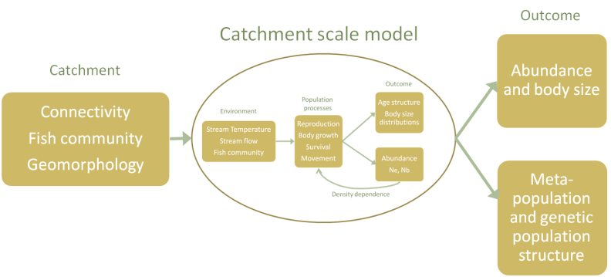
Approach
Outcome
Sub-watershed scale model
Abundance and body size
Among sub-watershed
Connectivity
Local climate
Meta-population and genetic population structure
Watershed scale model

Slide 62
Approach
Outcome
Sub-watershed scale model
Abundance and body size
Among sub-watershed
Connectivity
Local climate
Meta-population and genetic population structure
Among-watershed scale model

Slide 63
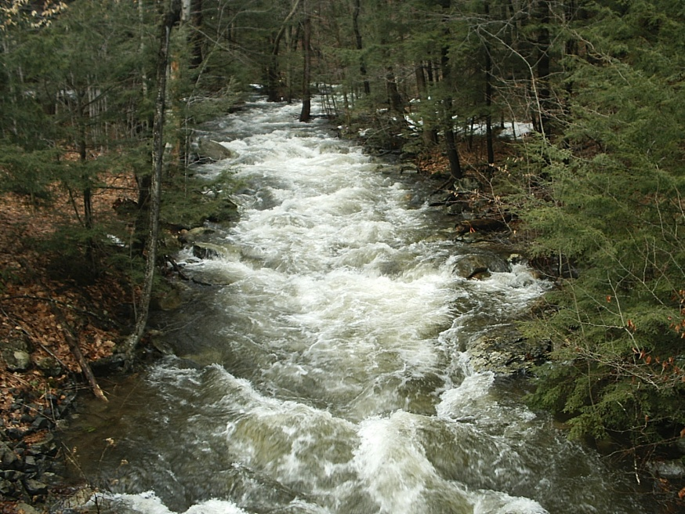
Data - isolation
Three cohorts
  2001, 2002, 2003
2524 tagged individuals
  12mm PIT tags (fish length >60 mm)
16 sampling occasions
  Two-pass electrofishing (20-m sections)

Slide 64
Emigration from tributaries
WB
OL
Probability of emigrating (∙Mo⁻¹)
OS
Isolated
Size state
Recolonization is key for persistence of currently connected tributaries

Slide 66
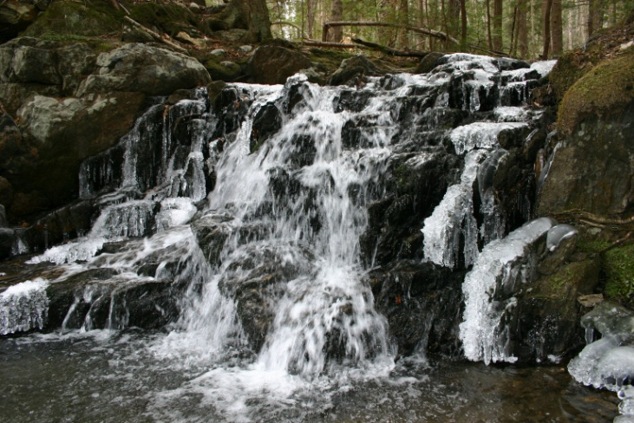
State variables
3 Locations
4 Sizes (FL, mm)
60-95 [0+]
96-115 [~1+]
116-135 [~2+]
>135 [~3+]
West Brook (WB)
OpenLarge (OL)
Isolated
OpenSmall (OS)
Estimate separately,
4 size states only
No seasonality, no density-dependence
Details in Letcher et al. PLoS One 2007

Slide 67
Isolation
One-way trip out
Isolation = Block entry to tributaries
Or, = mainstem habitat lethal
Tributary extinction times
West Brook + tributary extinction times
Extinction: <2 individuals in a tributary
WB
OL
OS
Isolated

Slide 68
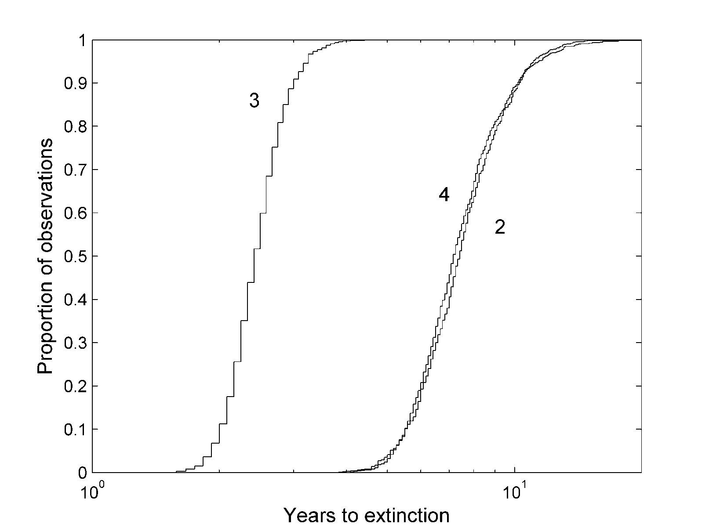
Open system tributary extinction times
2.9 yrs
10.1 yrs
Block OpenSmall
Block Both
Block OpenLarge
Generation time
= 1.9 years

Slide 69

How can the naturally-isolated tributary population persist?
NO immigration OR emigration for
isolated tributary
    Selection against movers?
    Genes for moving lost?
Genetic population structure
    Spatial variation?
Identify demographic differences between Isolated tributary and Open system
    Matrix modeling
WB
OL
OS
Isolated

Slide 70
Population genetics
OpenLarge tributary
100
Isolated tributary
85
OpenSmall tributary
Nei’s Genetic Distance
0.05
West Brook
Very strong evidence for reproductive isolation
Based on 12 microsatellite loci
Notes:
Something different about habitat or the fish between isolated and open?

Slide 71
Nominal matrices
Open System
    Fix λ = 1
    Early survival (emergence to tag) = 0.0336
    Generation time 1.90 years
Isolated tributary
    Fix λ = 1
    Early survival = 0.0488 (45% higher)
    Generation time 0.83 years
WB
OL
OS
Isolated

Slide 72
Size-dependent survival
Isolated
  Size-dependence: Yes
  Poor survival of large fish
  Fish do not move out
OpenSmall
  Size-dependence: Yes
  Large fish move out of OpenSmall
  WB a ‘refuge’ for large fish from tributaries
OpenLarge, West Brook
  Size-dependence: No
Probability of survival (∙Mo⁻¹)
Size state

Slide 73
Size-dependent survival
Isolated
  Size-dependence: Yes
  Poor survival of large fish
  Fish do not move out
OpenSmall
  Size-dependence: Yes
  Large fish move out of OpenSmall
  WB a ‘refuge’ for large fish from tributaries
OpenLarge, West Brook
  Size-dependence: No
Probability of survival (∙Mo⁻¹)
Size state

Slide 74
Stable stage distribution
More small fish in Isolated
More large fish in Open system
Stable stage distribution
Size state

Slide 75
Elasticity
Effect of a proportional change in matrix parameter(s) on lambda
Similar pattern to SSD
Summed elasticity
Size state

Slide 76
Elasticity
Similar pattern to SSD
Large fish particularly important in WB
Elasticity
Size state

Slide 77
Elasticities
Persistence of small tributaries
  Open small persists because large fish can leave and return to spawn
  Isolated persists because smaller fish are more abundant , reproduce earlier and contribute more to lambda
    Why don’t big fish leave???
Ratio of elasticities of Largest/Smallest size
⬇
⬇
Isolated OpenSmall OpenLarge WB

Slide 78
Demographic ‘rescue’
Can early survival in Isolated (45% higher) rescue OpenSmall and OpenLarge from isolation?
OpenSmall
  No, λ 0.88 ➔ 0.95
OpenLarge
  Yes, λ 0.94 ➔ 0.99
If novel isolation could select for higher early survival, isolated populations could persist
  How fast could pops evolve?
  Is isolation itself the selective agent?
WB
OL
OS
Isolated

Slide 79
Big concerns
x
  Small population size
    Too many confounding factors
  Loss of genetic variation
    Genetic drift
      Allelic diversity could be used, but confounding factors
      Would need landscape genetics approach to frame problem
    Evolutionary response?
      Selection against movers or large fish
        SNPs for movement/growth/age of maturity? Promising, but long-term
  Life history shifts
    Age at maturity – consistent enough? Not easy to measure
    Growth rate – confounding factors, common environment studies difficult
Down
Up

