Slide 1





Climate Change Scenarios for Brook Trout Persistence: Issues of Scale
Mark Hudy
October 2010
US Forest Service Fish and Aquatic Ecology Unit, Harrisonburg, VA

Slide 2
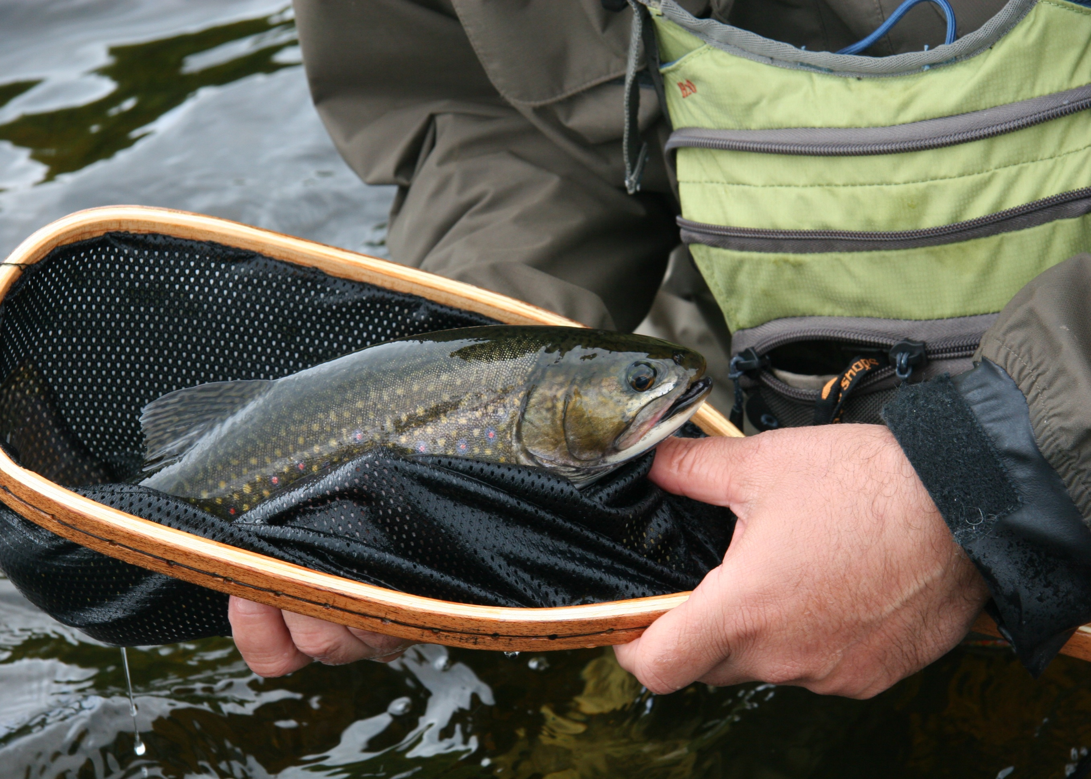
Introduction

Slide 3
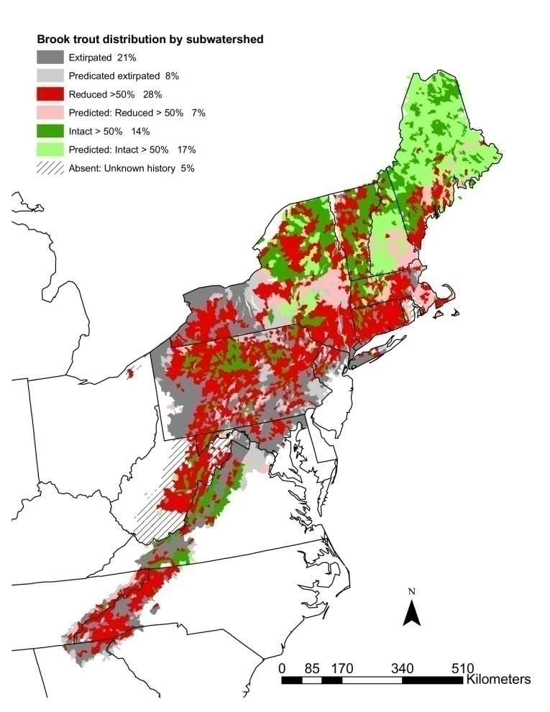
Brook Trout Range
29 % of brook trout subwatersheds have been extirpated (EBTJV 2005)
No known population losses because of climate change

Slide 4
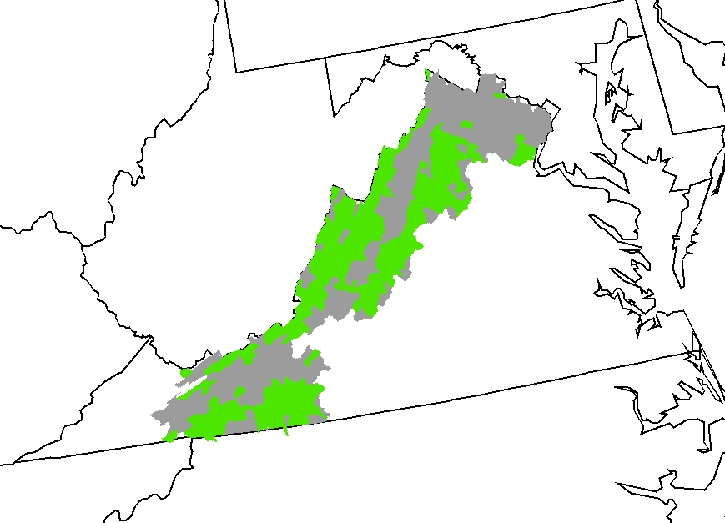
Case Study: Virginia
Brook Trout Habitat
Extirpated
Intact

Slide 5
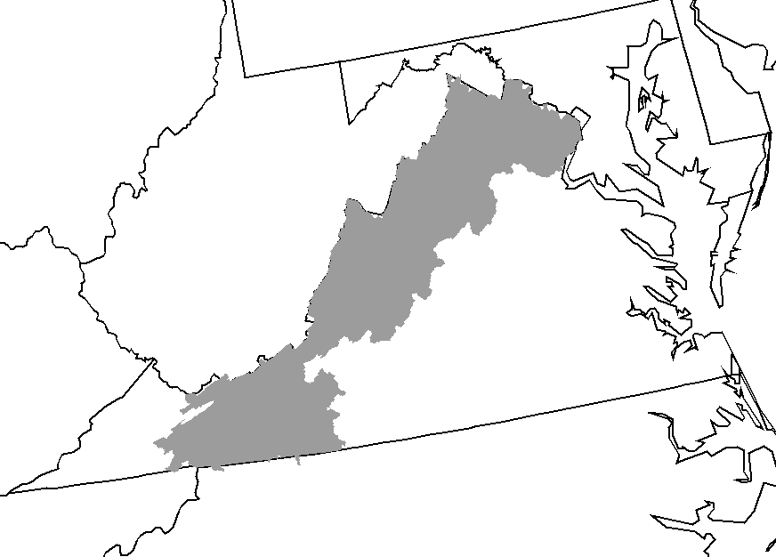
Under various climate change scenarios, brook trout are predicted to be extirpated from parts of the historic range ( i.e. Virginia)
Flebbe et al. 2006. Spatial Modeling to Project Southern Appalachian Trout Distribution in a Warmer Climate. TAFS
Clark et al. 2001. Predicting Climate Change Effects on Appalachian Trout: Combining GIS and Individual –Based Modeling. Ecological Applications.
Meisner. 1990. Effect of Climatic Warming on the southern margins of the Native Brook Trout . CJAS
Brook Trout Habitat
Extirpated
Intact

Slide 6
Secondary Data Used in Regional Models
Air Temperature:
  Mean annual maximum air temperature (PRISM; 800 m grid)
  Air Temperature from Elevation or Elevation/Latitude models
  Models from local weather stations ( i.e. airports, NOAA)
Water Temperature:
  Usually no direct measurements
  Assume a steady relationship between air and water temperatures (i.e. 1°C air temp rise = 0.8°C water temp rise)
Focus on elevation and latitude as driving metrics in temperature relationships:
  ∆188m elevation → 1°C air temp rise = 1°C water temp rise (Flebbe et al. 2006)

Slide 7
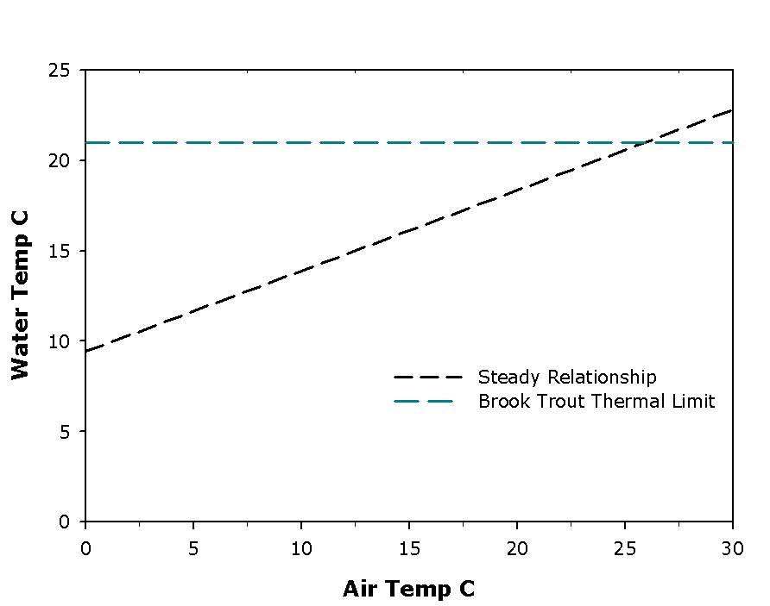

Slide 8
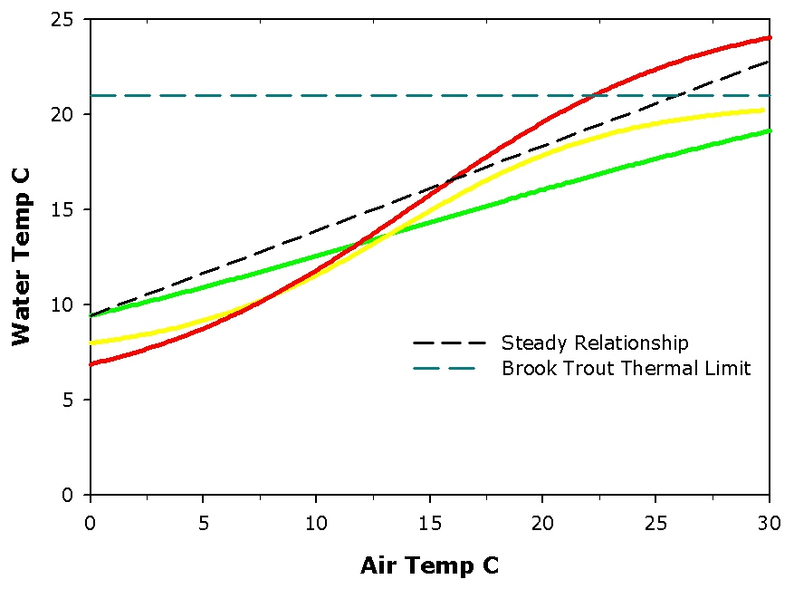

Slide 9
Objectives

Slide 10
OBJECTIVES
Directly measure variability between air and water temperature during critical summer period (July 1 – September 30).
Develop a classification system for managers using sensitivity and vulnerability metrics

Slide 11
Conceptual
Model
High Sensitivity/Low Vulnerability
High Sensitivity/High Vulnerability
Low Sensitivity/Low Vulnerability
Low Sensitivity/High Vulnerability
Sensitivity
Vulnerability

Slide 12
Sensitivity Metric
  The change in the daily maximum water temperature (DMAXW) from a 1°C increase in the daily maximum air temperature (DMAXA)

Slide 13
Vulnerability Metrics
Average Standardized Score (x-mean)/SD
Duration (consecutive days above 21°C)
Proportion (frequency of days above 21°C)
Magnitude (average DMAXW of all DMAXW days over 21 °C)

Slide 14
Study Area

Slide 15
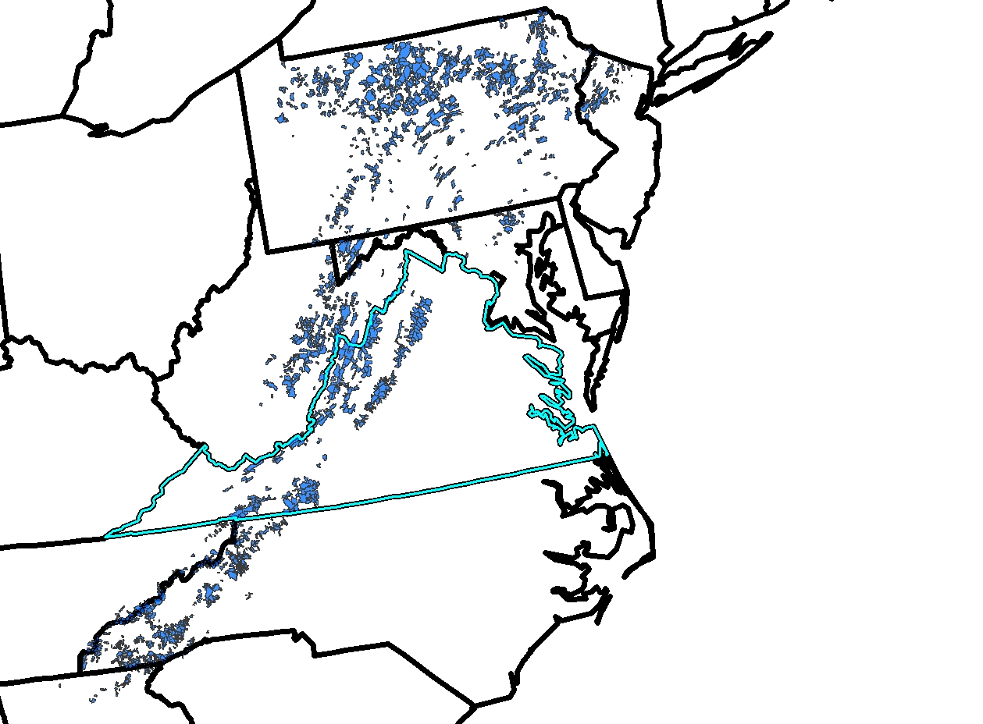
Patches of Brook Trout
(n = 2,329)

Slide 16
Methods

Slide 17
Sample Units

Slide 18
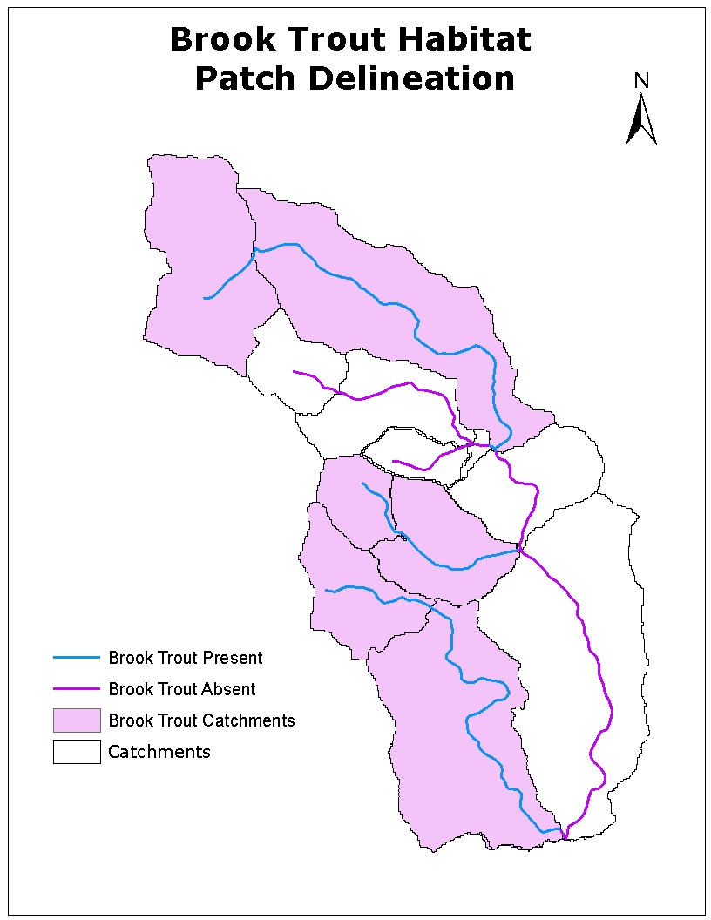
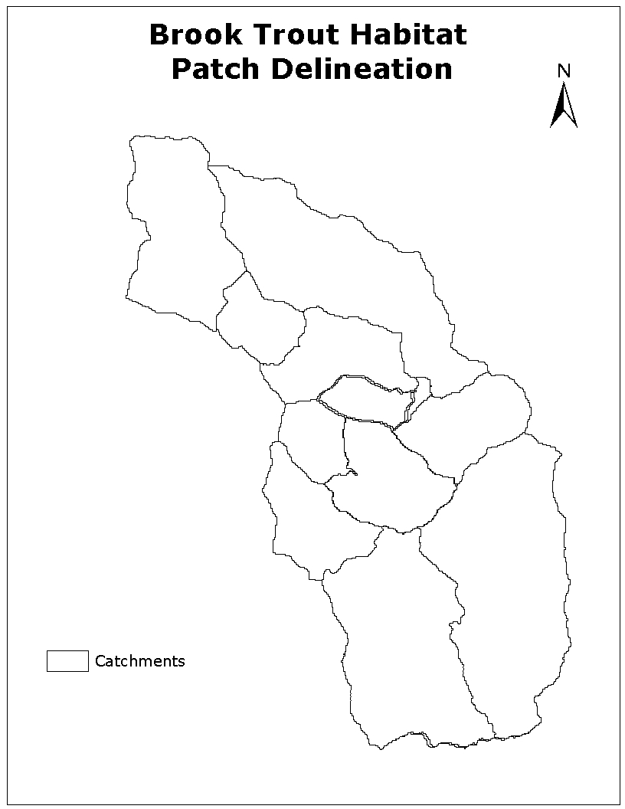
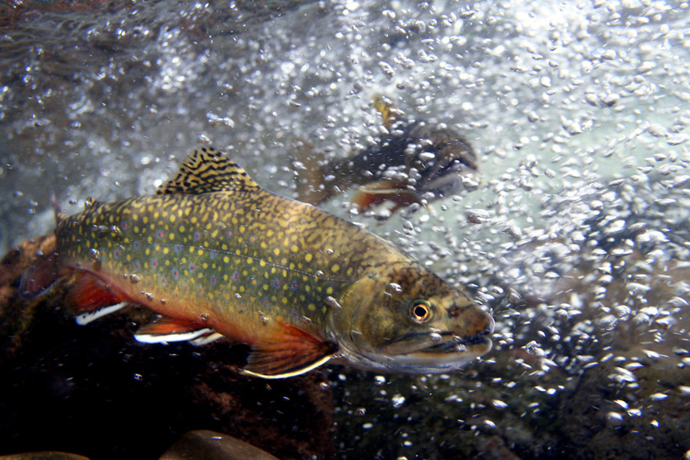
1. NHD⁺ catchments
2. Classify catchments by brook trout status
Dam
http://www.fisheyeguyphotography.com/pics/trout-small/brook-trout-photo-77.jpg

Slide 19
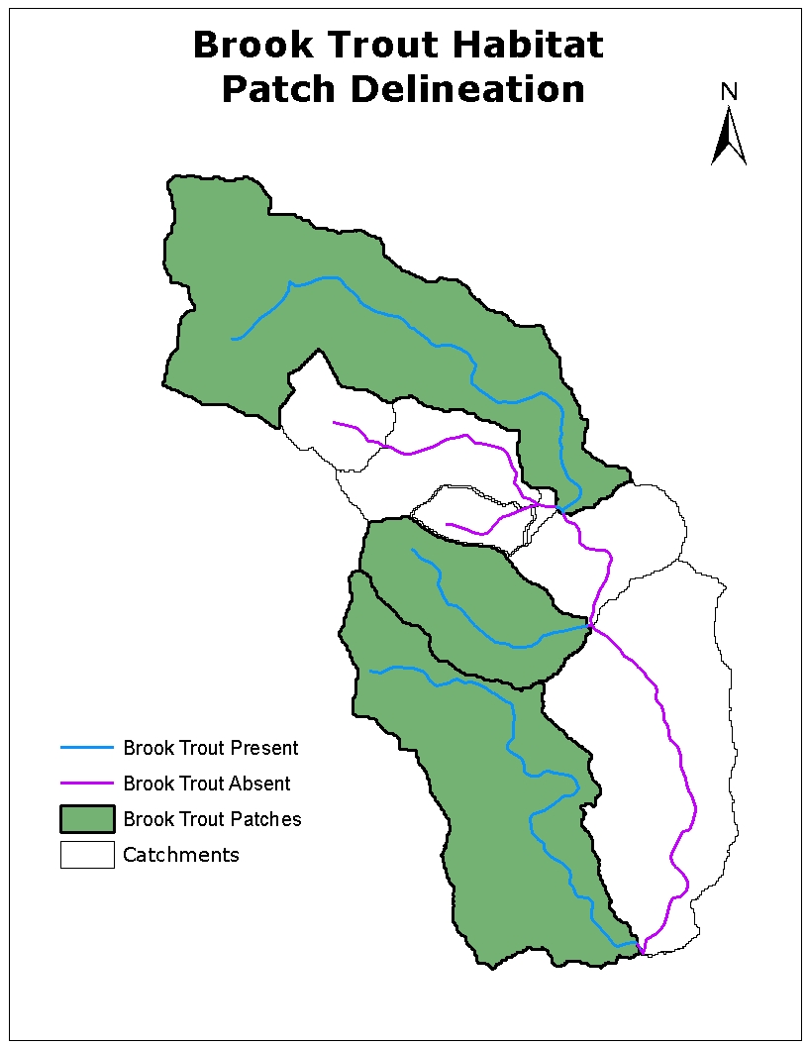
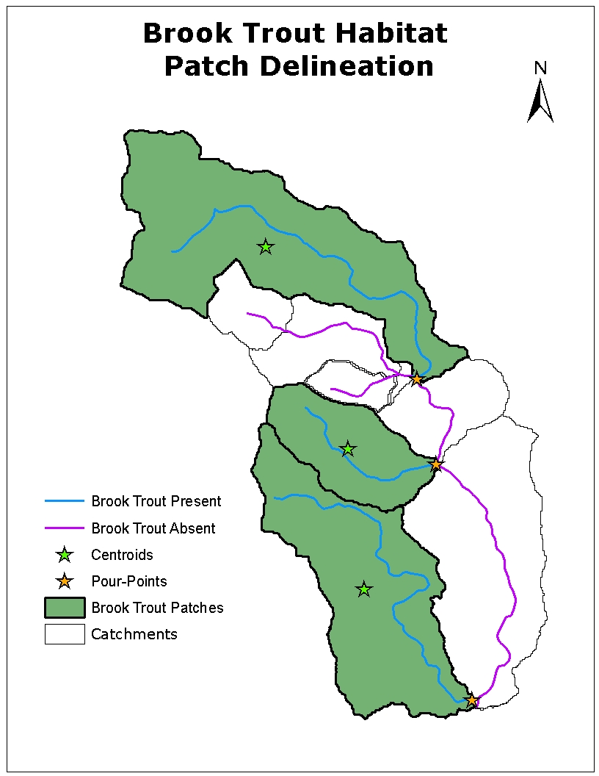
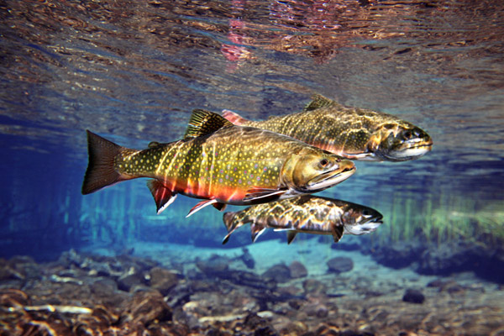
3. Dissolve contiguous brook trout catchments into sample units (“Patches”)
4. Directly measure paired air and water temperature at patch centroid and pour-points
http://www.fisheyeguyphotography.com/pics/trout-small/brook-trout-photo-49.jpg

Slide 20
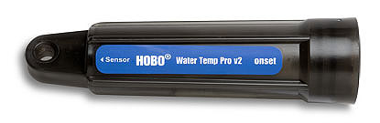
Thermographs
Temperature data is being collected at 30 minute intervals with focus on the critical summer periods (July-September 30)
This talk focuses on daily maximum water (DMAXW) and daily maximum air (DMAXA)
Onset HOBO Water Temp Pro v2
Operation Range: -20 to 70°C
Accuracy: 0.2°C over 0° to 50°C
Resolution: 0.02°C at 25°C

Slide 21
Results

Slide 22
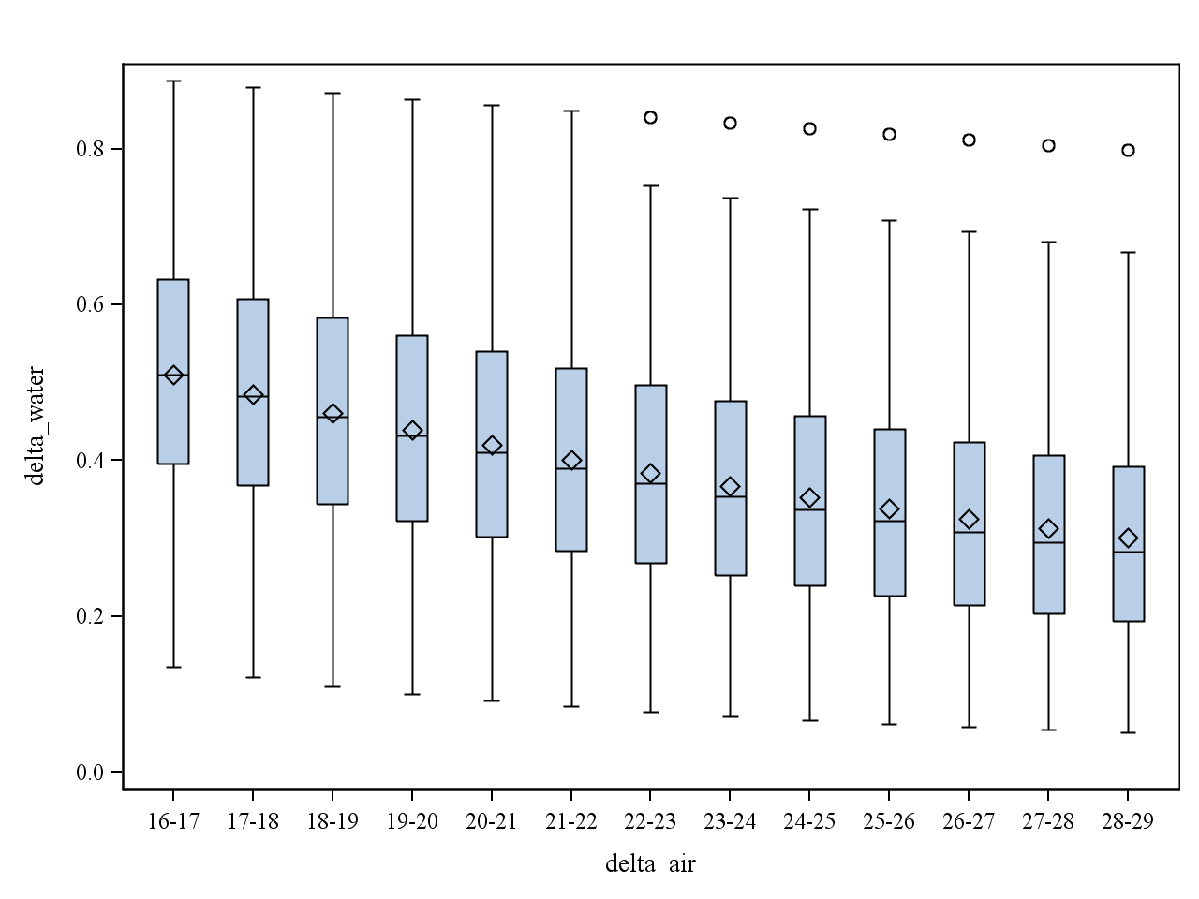
Sensitivity
(Secondary Data)

Slide 23
Sensitivity
(n = 77 )
DMAXW Mean ∆ 0.38

Slide 24
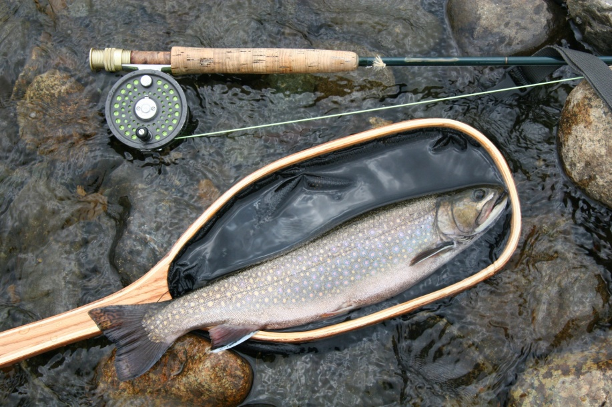
Vulnerability
  Duration:
  Mean 11.75 (SD =17.1) range 0 to 56 days
  Proportion:
  Mean 23% (SD = 29.0 %) range 0.0 to 91.0%
  Magnitude:
  Mean 0.76 (SD = 0.99) range 0.00 to 3.80

Slide 25
Conceptual
Model
High Sensitivity/Low Vulnerability
High Sensitivity/High Vulnerability
Low Sensitivity/Low Vulnerability
Low Sensitivity/High Vulnerability
Sensitivity
Vulnerability

Slide 26
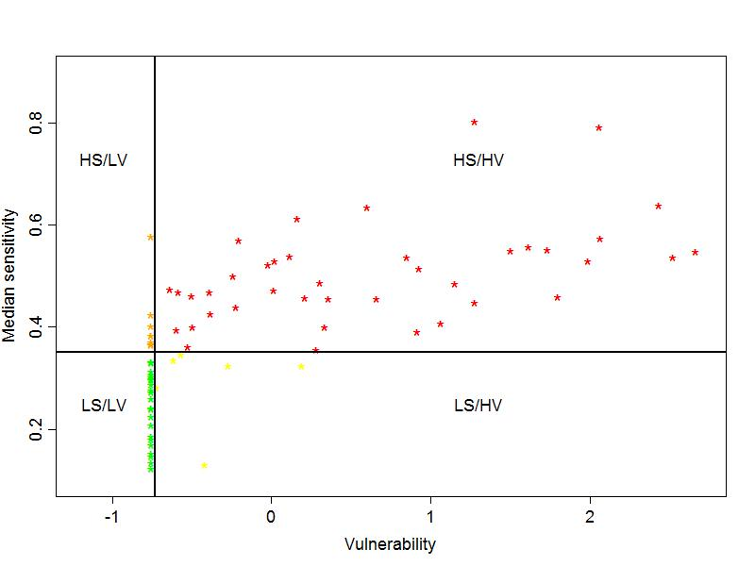
Sensitivity/Vulnerability Habitat Classification
10.4%
51.9%
29.9%
7.8%

Slide 27
Discussion

Slide 28
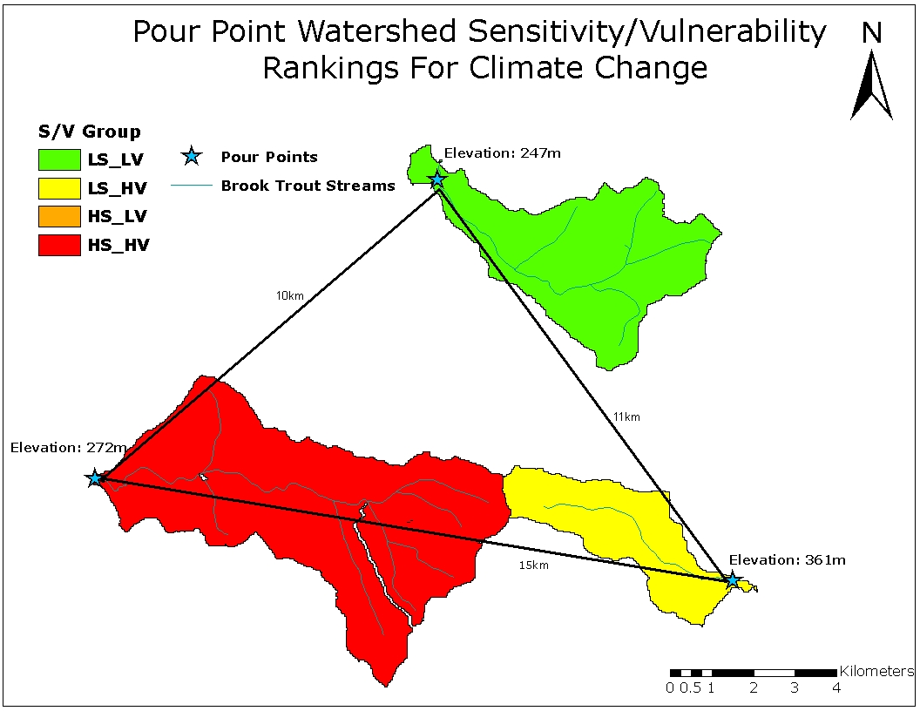

Slide 29
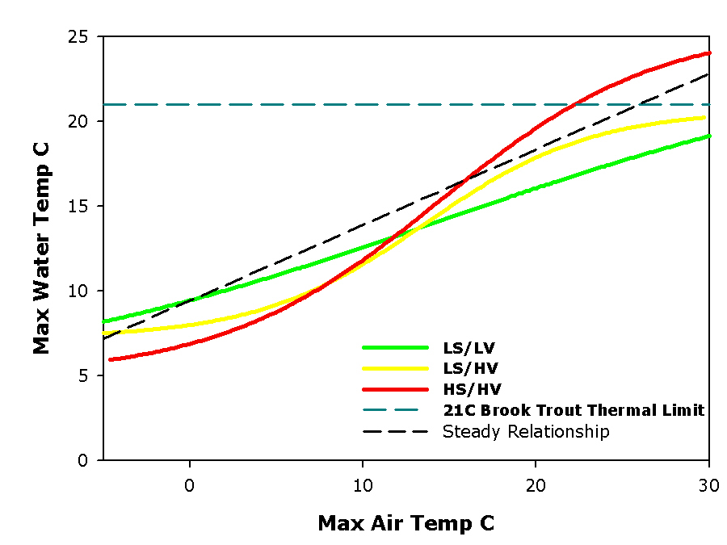

Slide 30
Can Managers Risk a Type I or Type II Error
Investment of $100’s k in restoration ?
Selection of conservation populations (genetic integrity)

Slide 31
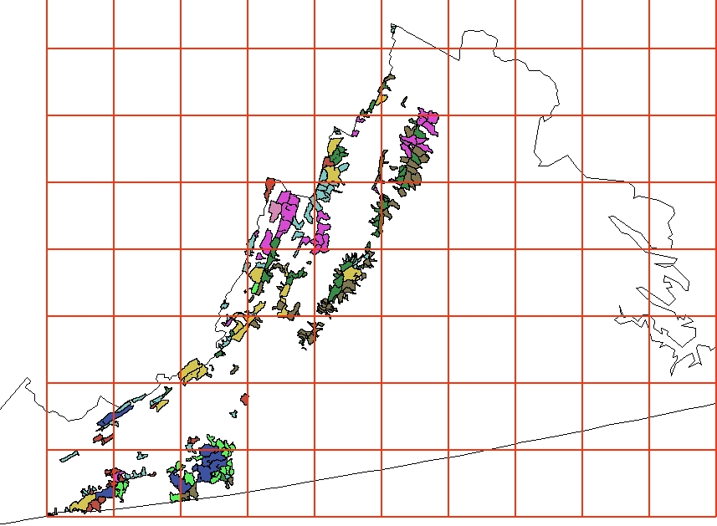
Climate change Scenarios

Slide 32
Acknowledgements
VA Department of Game and Inland Fisheries for HOBO funding
US Forest Service Northern and Southern Research Station
James Madison University, Department of Biology
Virginia Tech
USFWS

Slide 34
Candidate Model Metrics??

Slide 35
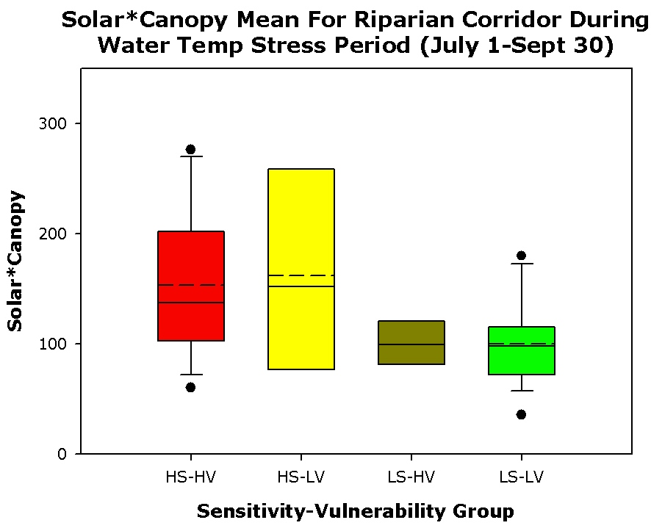
Solar Gain Metric
  Latitude
  Longitude
  Elevation
  Aspect
  % Canopy Cover
  Hill Shading
http://www.tnaqua.org/newsroom/HighRes/BrookTrout_exhibit.jpg
http://www.tnaqua.org/newsroom/HighRes/BrookTrout_exhibit.jpg

Slide 36
Predictive Scale Appropriate Models: CART??
Solar gain
  Hill shading
  Aspect
  Lat/long
  Canopy cover
Elevation
Patch area
groundwater
???????

Slide 37
Sensitivity Metric
  The change in the daily maximum water temperature (DMAXW) from a 1°C increase in the daily maximum air temperature (DMAXA)
High Sensitivity (HS) = patch median > 0.38°C
Low Sensitivity (LS) = patch median < 0.38°C

Slide 38
Vulnerability Metrics
Average Standardized Score (x-mean)/SD
Duration (consecutive days above 21°C)
Proportion (frequency of days above 21°C)
Magnitude (average DMAXW of all DMAXW days over 21 °C)
High Vulnerability (HS) = any value of DMAXW over 21°C
Low Vulnerability (LS) = all values of DMAXW under 21°C

