Slide 1
GeoNode
Uploading Data
Matthew Hanson
mhanson@ags.io

Slide 2
GeoNode Overview
GeoNode made up of several components
Web Framework – Django
OGC Server – GeoServer
Database – PostGIS
A library, for geospatial data
View/upload/edit through website
Use services from external clients
Quantum GIS (QGIS) – connect to Web Mapping Service (WMS)

Slide 3
Geospatial Data
Projections identified by EPSG code (most common)
epsg.io – website reference for all projections
Common Projections
EPSG:4326 – Geographic or ‘WGS-84’
units in degrees
EPSG:3857 – Web Macator or “Google” projection
used for viewing (google maps, openlayers)
Equal area projections useful for analysis
EPSG:42303 – Albers North America
Units in meters
UTM – Universal Transverse Mercator
Smaller areas called zones (each one different EPSG code)
Units in meters
For uploads the projection doesn’t really matter…

Slide 4
Layers vs Maps
Layers
Collection of data
Vector
Collection of one geometry type (e.g., polygon, linestring, etc)
Raster
Collection of raster bands (e.g., colors)
Metadata
Abstract, source, temporal and spatial extent, point of contact
Maps
Collection of multiple layers of data

Slide 5
Conservation Design
Front page
Recent layers and maps
Links to main pages
Upload Layers
Create Maps
Explore (Browse)
Search
Future options
News/blog
Featured apps or data

Slide 6
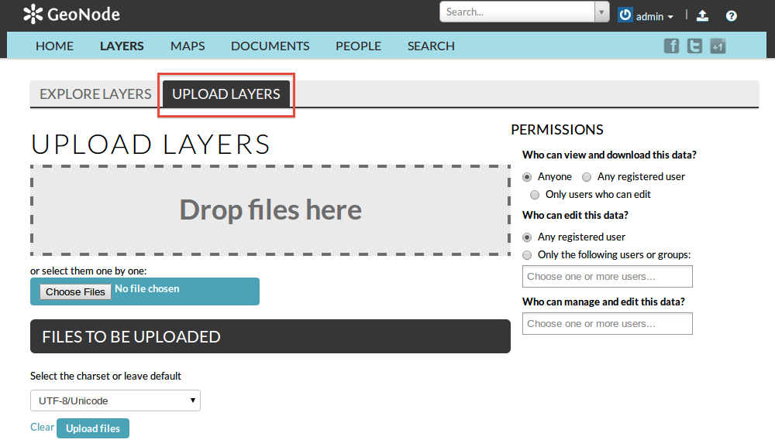
Upload Layers
Upload multiple files
Any combo of raster/vector
Drag and Drop
File Dialog
Batch permissions
Other batch options
GeoServer
PostGIS
GeoNode command line

Slide 7
Vector and Raster
Vector Uploads
ESRI Shapefiles
files
.shp - geometry
.shx – index
.dbf – attributes
.prj – projection
.sld – style (optional)
.xml – metadata (optional)
Zip file containing all of above
Raster Uploads
GeoTiff
May contain multiple bands

Slide 8
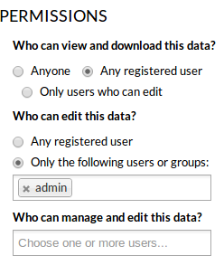
Permissions
Layer Permissions
Set when uploading
Change from layer info page (must be logged in)
Edit Layer -> Edit Permissions
“Anyone” – means anonymous access allowed
Map Permissions
Set when creating
Change from map info page (must be logged in)
Edit Map -> Edit Map Permissions
Groups
Not in current version (2.0)
Feature added in 2.1

Slide 9
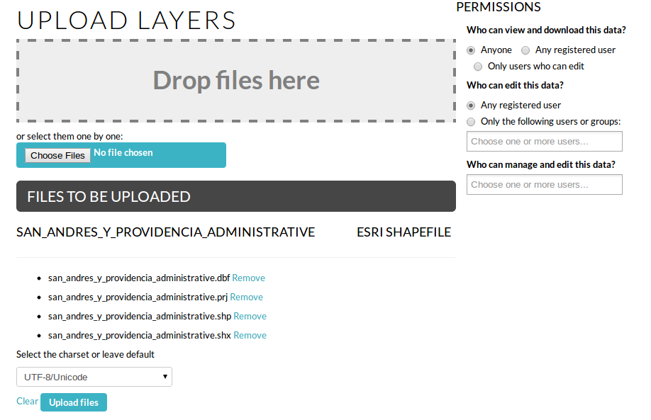
Ready to Upload

Slide 10
Upload Success!
If successfully uploaded, the message above will be displayed
Layer Info
main layer viewing page
Edit Metadata
Fill in metadata…..very important!
Spatial data without metadata is of limited use (when, where, why, contact?)
Manage Styles
Edit, or create new, styles for the layer
All styles available with this layer to users

Slide 11
Layer Info
Each layer (or map) has own Info page
View data (zoom/pan)
Feature Info (e.g. polygon attributes)
Download data
Variety of formats (e.g., tif, shapefile, jpg, kml)
Download metadata
Varity of formats (e.g., DIF, ATOM, ISO)
Replace or remove data
Social features
Comment, rate, share

Slide 12
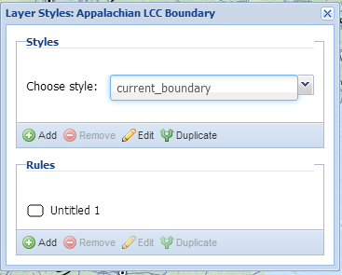
Styles
Data layers may have multiple styles
Add new or duplicate
Use Style Manager to select available styles
Style information stored in .sld files
Include .sld file during upload
Use GUI to edit rules
Vector styling full featured
Complex raster styles more difficult

